Slide 1
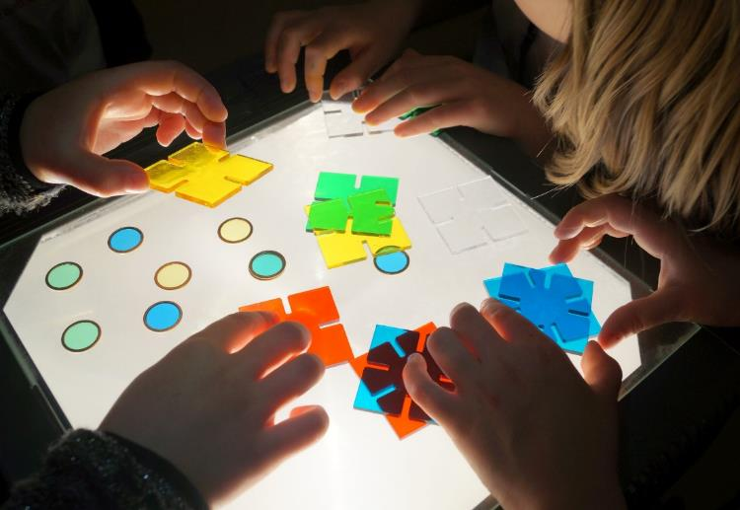
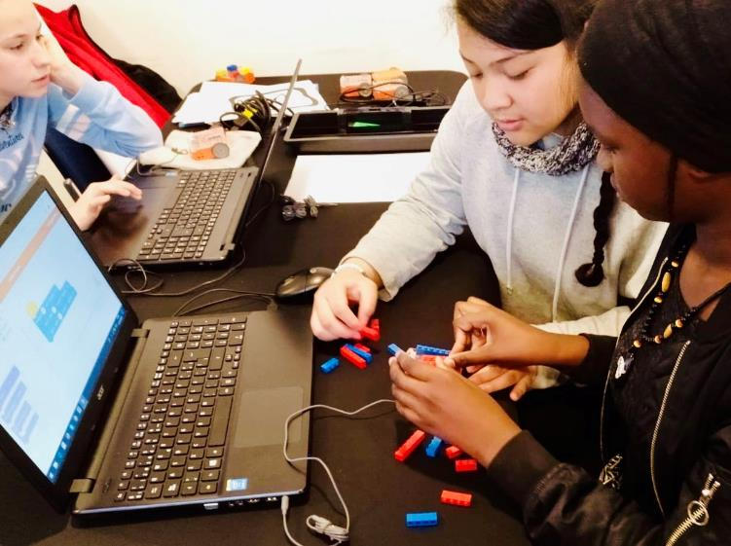
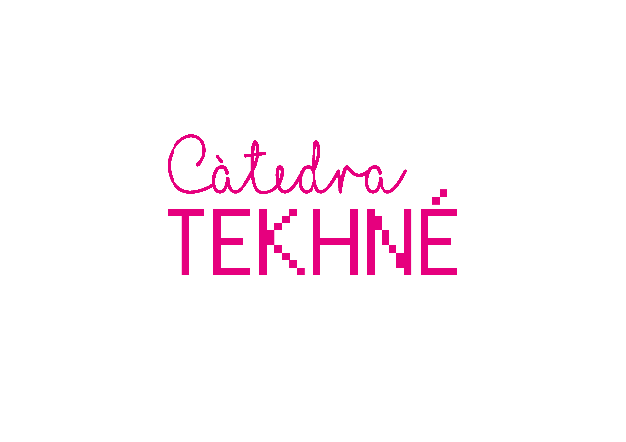


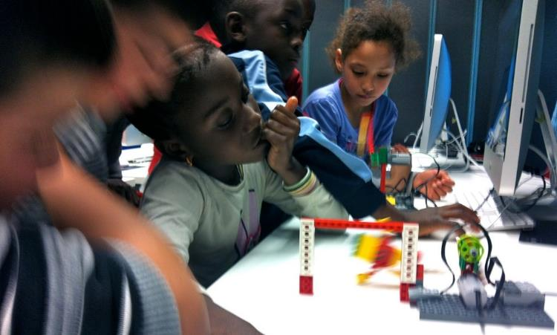
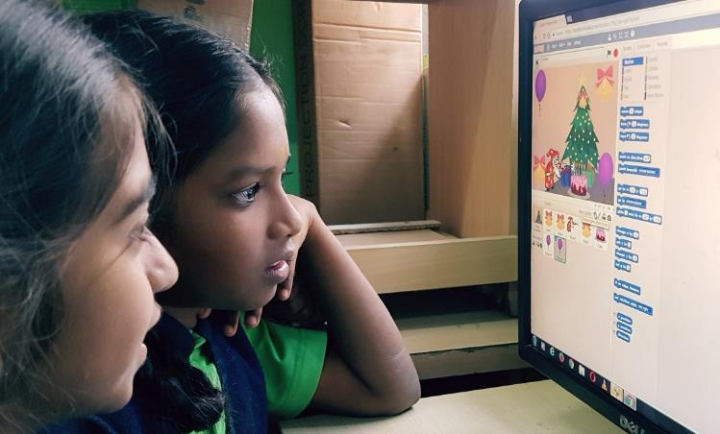

Slide 2
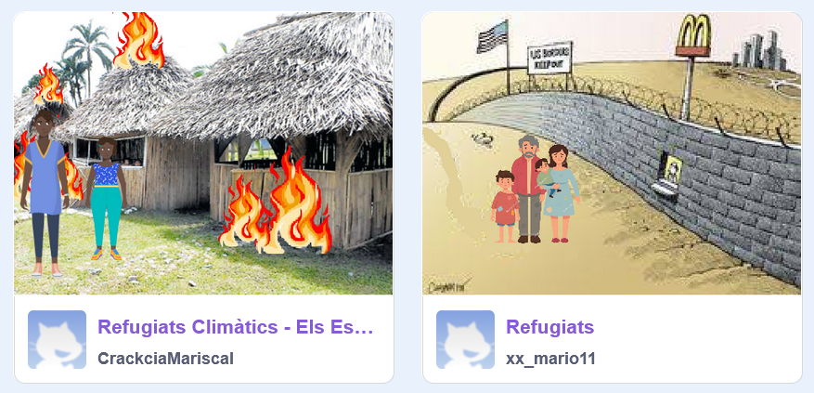
Digital Storytelling
With Scratch

Slide 3
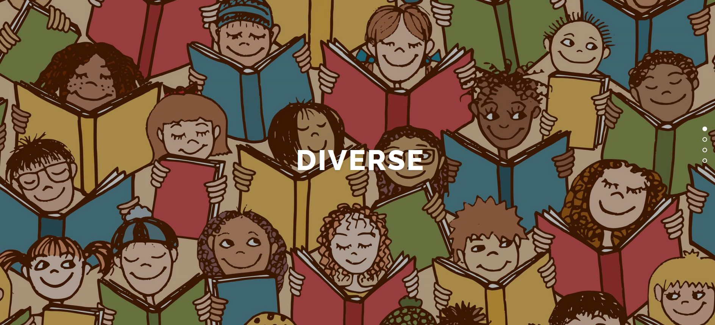
Project DIVERSE (Erasmus+) 2019-2021
http://diverse-education.eu/
Methods:
- Folk Tales
- Drama in Education
- Digital Storytelling

Slide 4
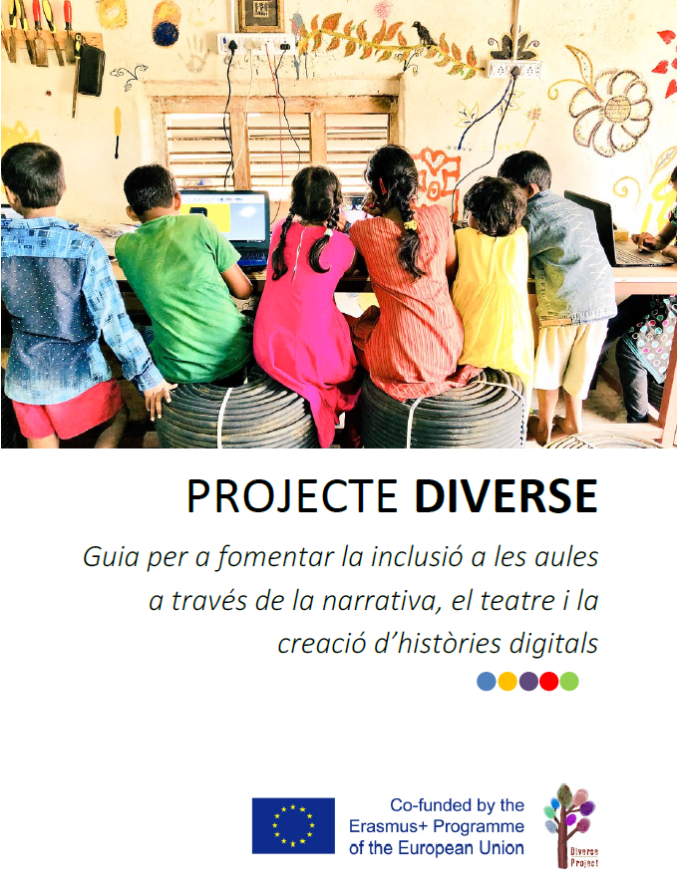
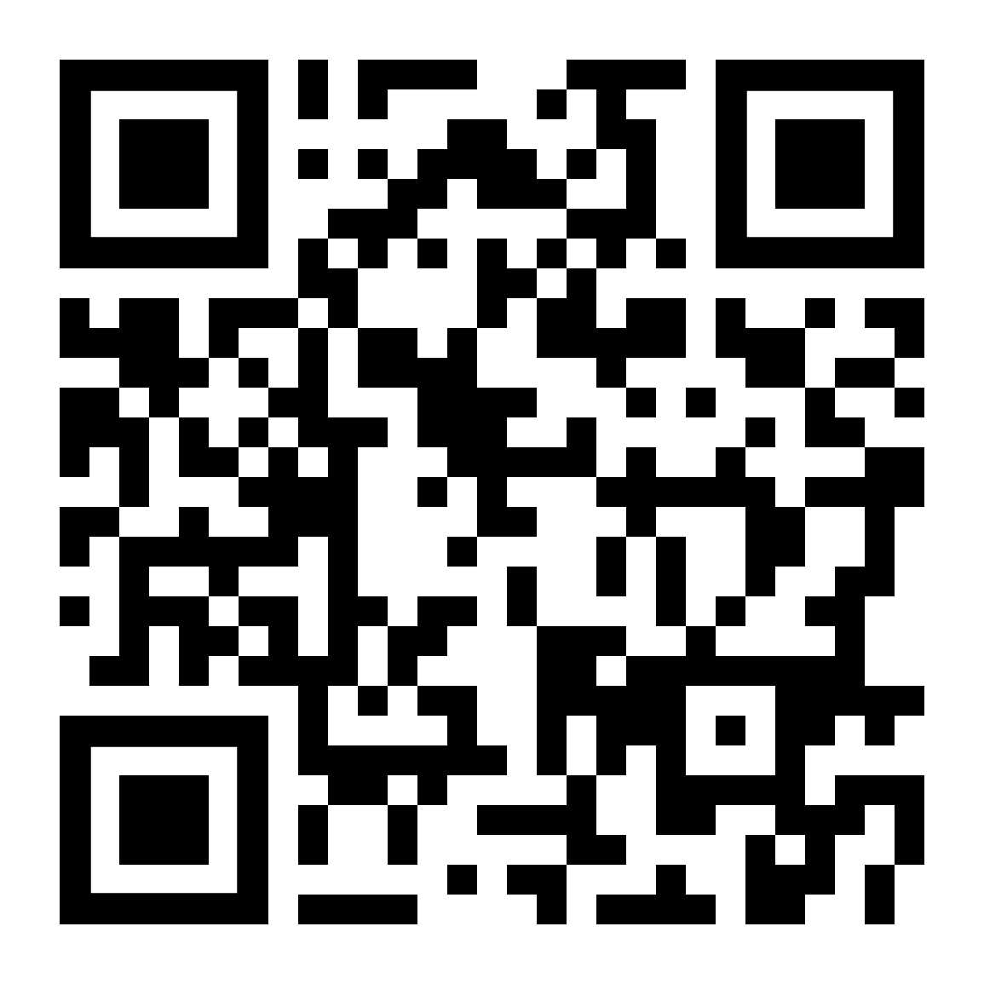
Project DIVERSE (Erasmus+) 2019-2021
Guidance book
for Teachers
http://diverse-education.eu/guidance-book/

Slide 5
Why Digital Storytelling?

Slide 6
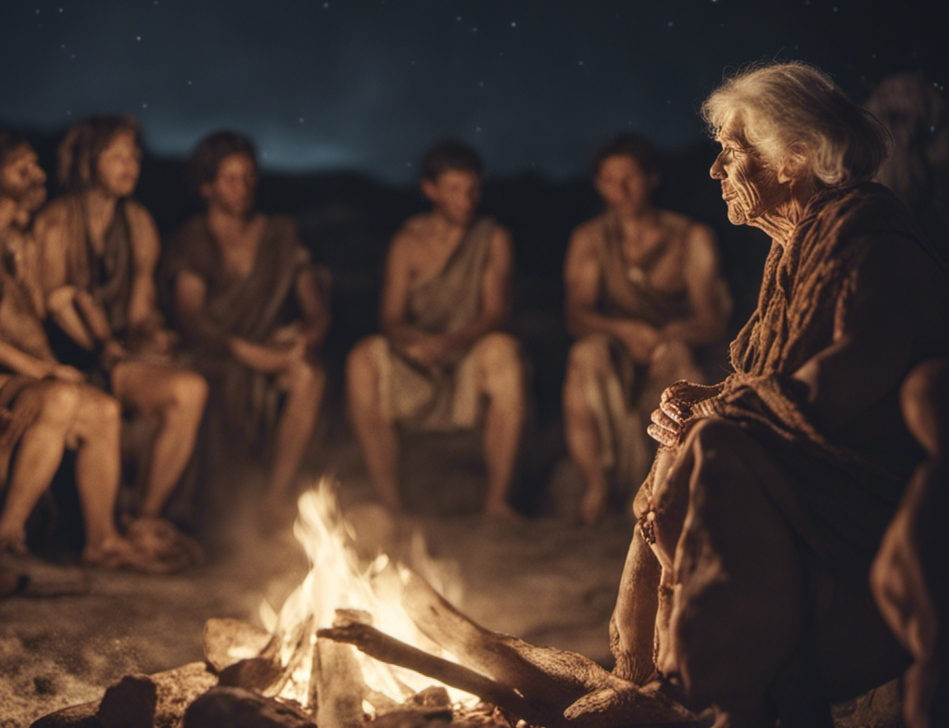
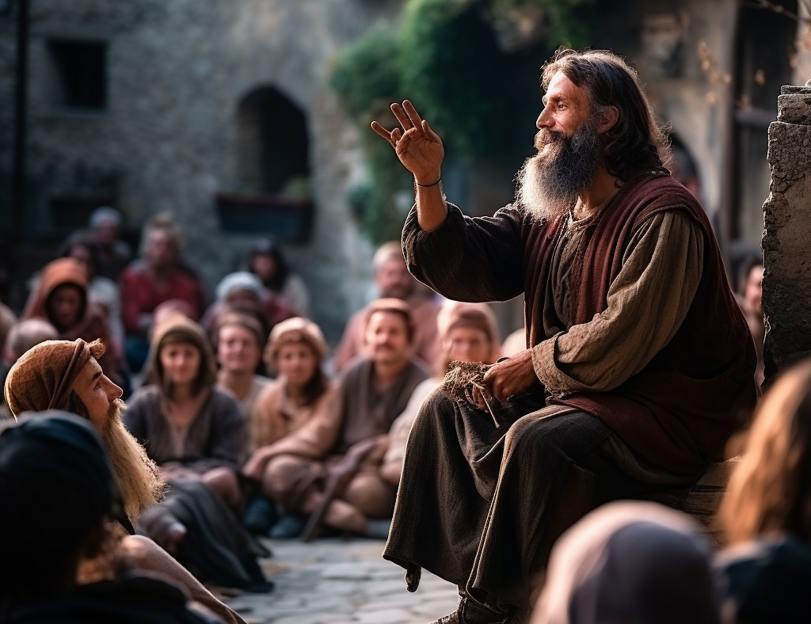
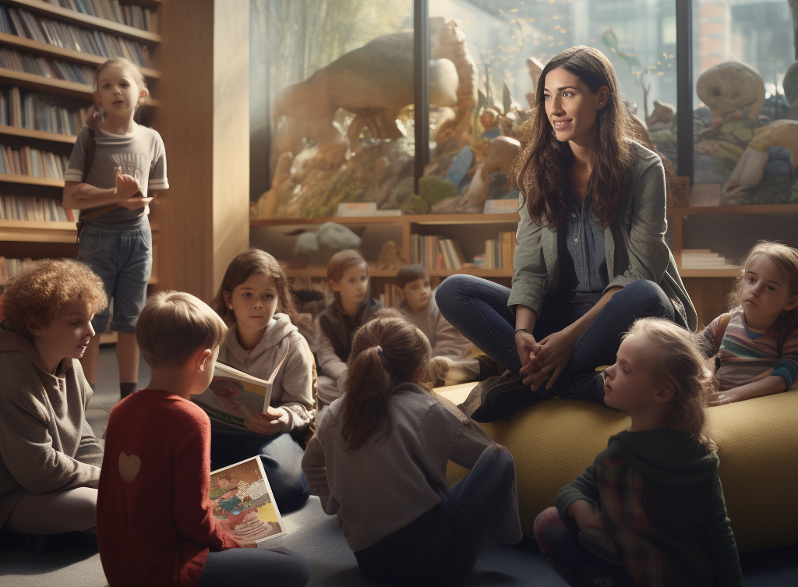
Since the dawn of civilization, humans have needed to share and connect through stories.
Stories transcends mere entertainment; they are a profound expression of our desire to understand and be understood. Stories serve as bridges, linking us across generations, cultures, and experiences. They give voice to our joys, sorrows, dreams, and fears…

Slide 7

Why storytelling in Education?
Storytelling in education fosters engagement and deepens understanding by connecting lessons to relatable human experiences.
It harnesses the power of narrative to make abstract concepts memorable and to cultivate critical thinking and creativity in students.

Slide 8
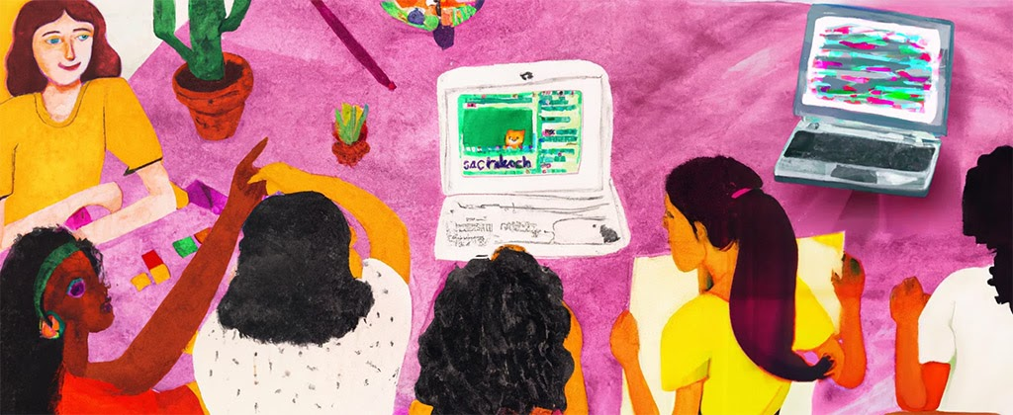
What makes storytelling digital?
Use of digital tools and platforms to tell stories.
Combines various forms of media – text, audio, video, and images.

Slide 9
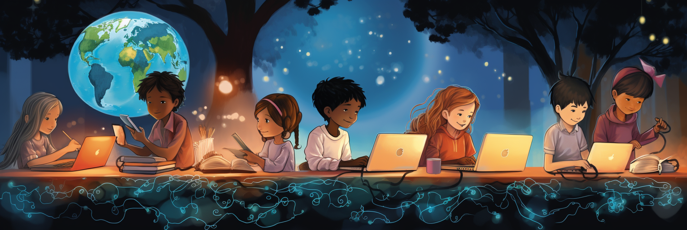
Benefits of Digital Storytelling in Education
Engagement (Multisensory Experience, Interactivity, Dynamic Content…)
Creativity: Digital tools provide a plethora of ways to express oneself.
Critical Thinking: Planning a narrative requires organized thought.
Technical Skills: Familiarity with modern digital tools.
…

Slide 10
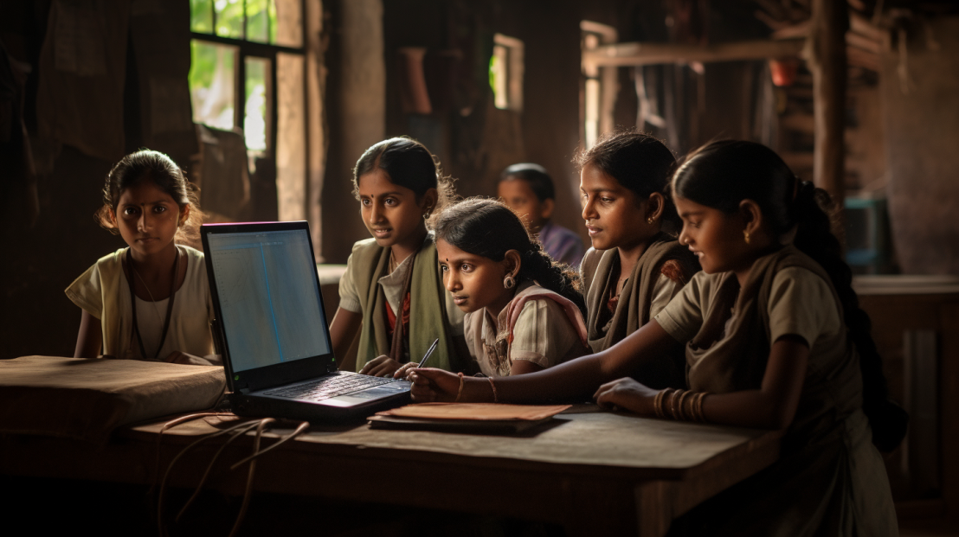
Digital storytelling goes beyond just educators using digital stories as a tool for creating engaging content in the classroom.
It also provides a unique opportunity for children to express themselves through digital media.
By encouraging students to create their own digital narratives, we empower them to unleash their creativity and develop essential skills in communication, technology, and storytelling.

Slide 11

Digital storytelling does not mean the abandonment of traditional methods; in fact, it thrives when it embraces a harmonious blend of both digital and conventional approaches.
By integrating digital tools with traditional storytelling techniques, we can create a richer and more versatile learning environment.
This hybrid approach allows educators to harness the benefits of technology while preserving the timeless art of storytelling through books, oral traditions, and other analog methods.

Slide 12
Why Scratch?

Slide 13
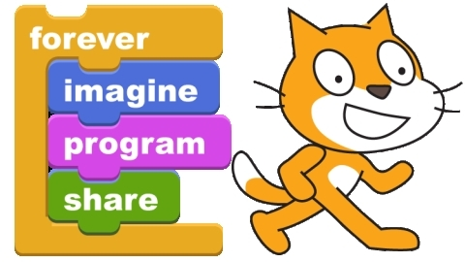
scratch.mit.edu
Notes:
LEMA INSPIRADOR…
LOGOTIP
A CONTINUACIÓ, I ABANS D’ENTRAR EN DETALLS DELS PROJECTES, US VULL MOSTRAR UNES POQUES TRANSPERENCIES AMB IMATGES I PARAULES CLAU DEL GRUPDE RECERCA

Slide 14
WHY SCRATCH?
  It's online and free, you don't need to install any special software to start creating.
  It is multiplatform, and works on computers as well as tablets and mobile phones.
  It is translated into many languages.
  It is designed with a very powerful pedagogical approach, and allows learning in a very intuitive way, facilitating self-learning and learning by discovery and exploration.
  It allows us to create digital stories, but also games, artistic projects, simulations, etc.
  It allows to share our creations on the Internet, in a very easy way, and also allows to remix the creations of others, which is a very powerful feature.
  It is not only a tool and an environment but also a huge community.
  Scratch has a low floor, high ceiling and wide walls.
  It has extensions that allow us to play with music, give voice to our characters (recording or text-to-speech), connect the story on our screen with the outside world (sensors, robots, etc.).

Slide 15
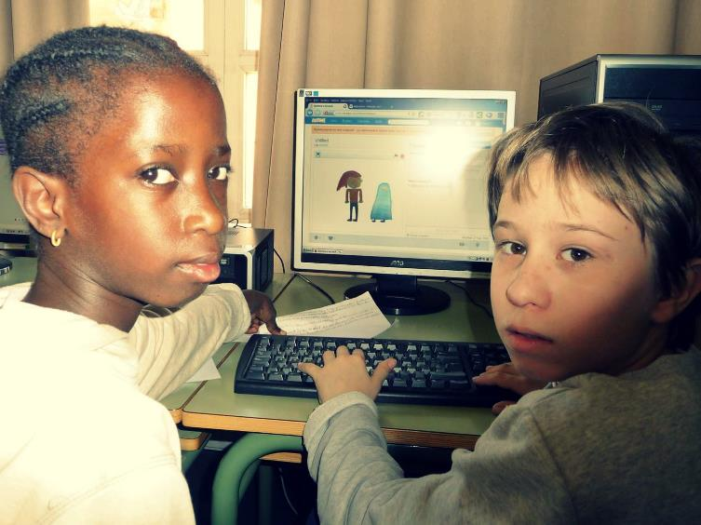
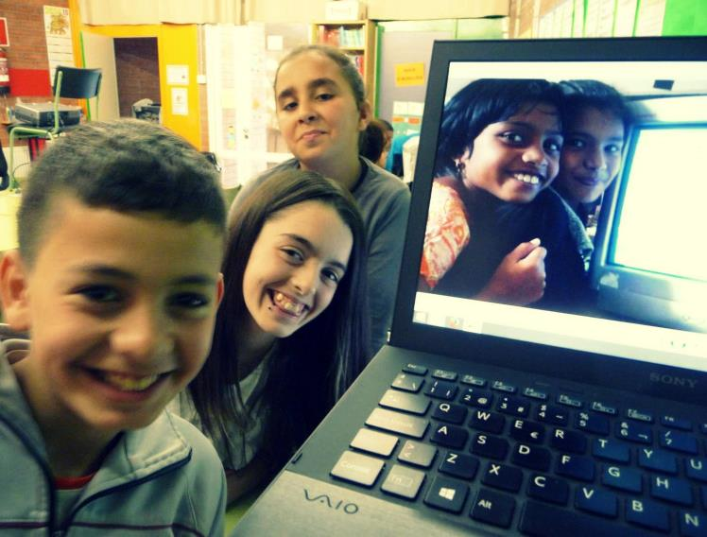
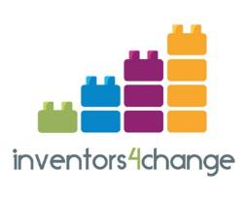
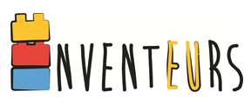

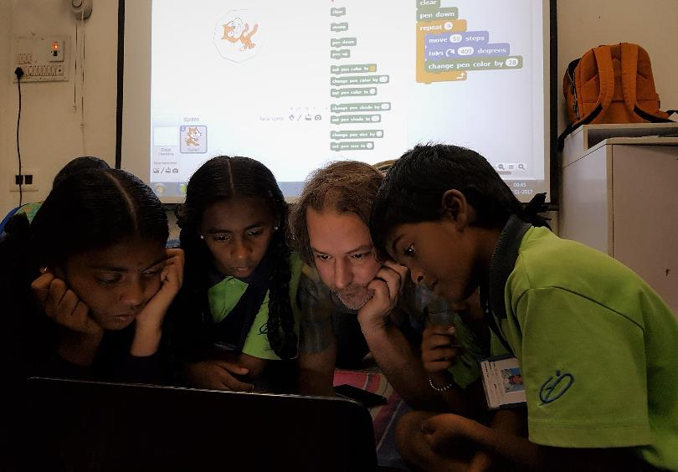
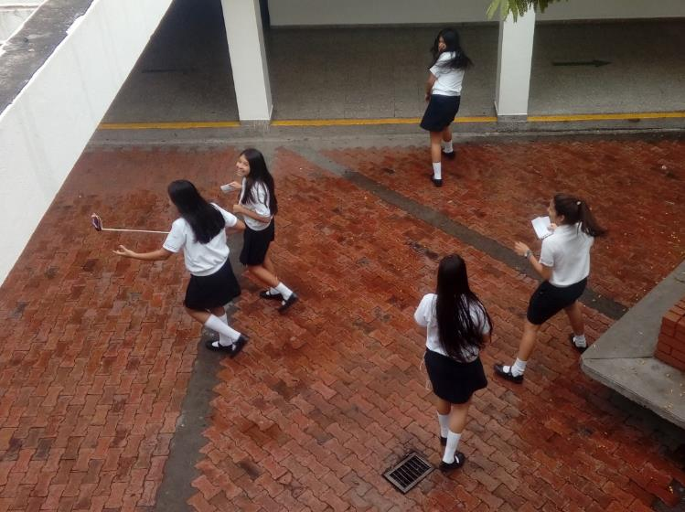

Slide 16
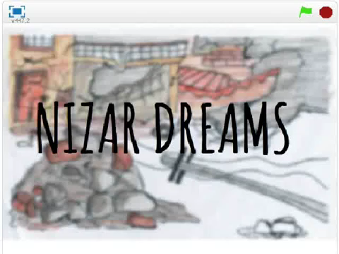

Slide 17
http://scratch.mit.edu/

Slide 18
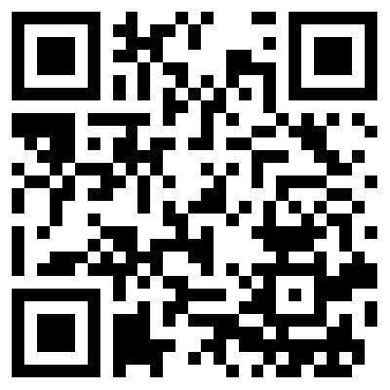
Acadimia Scratch Studio

