Slide 1


ACAδIMIA Project
EAR methodology Workshop on Socratic Dialectics and Drama
FLORENCE TRAINING 18/10/2024
face to face

Slide 2
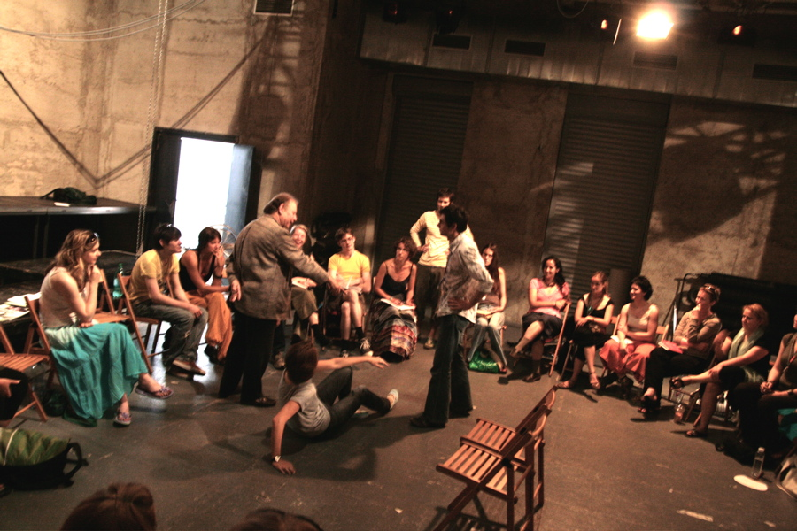
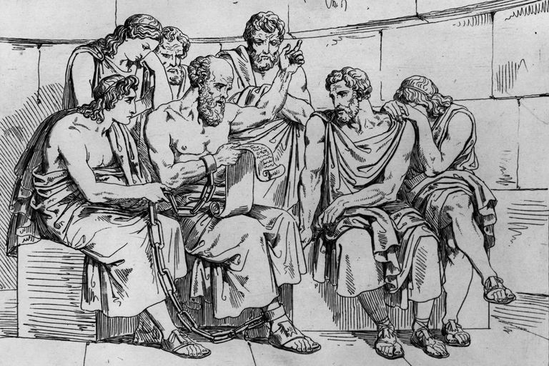

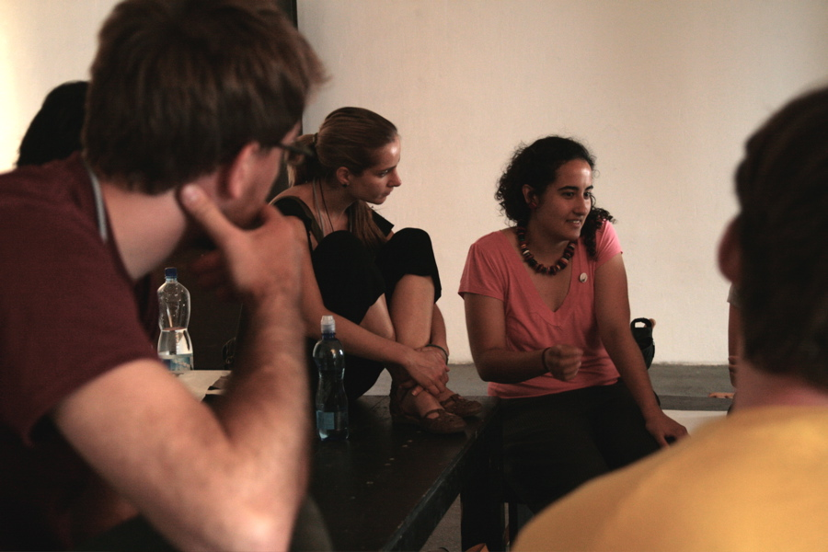
The EAR concept
Notes:
Natasha Balaska

Slide 3

Let's start! Homocentric cycles
Should the police enter the Universities? Should a University be an asylum space for everyone?
Should an employee who knows his boss is trying to corrupt the civil servants follow his orders or risk to be fired?
Should a doctor save the life of a child or the life of an old man first when he has no time for both?
Should a priest who misused his power and harassed a woman in the church be punished with a special exemplary punishment?
Should we continue the exams online? Are they safe and real?
Should different commercial enterprises be free to organize all kinds of events they want in public monuments like the Acropolis?
Should the policemen have the right to go on strike?
Should no homework be assigned in school and let children more free time?
Should we have cameras (everywhere) in schools?

Slide 4
Let's start! Homocentric cycles
The DNA or the environment most defines what we are?
are you pro or against euthanasia to a person who suffers?
Should we reestablish the death penalty for people who do not regret a serious crime?
Should a teenage girl decide an abortion if she does not want the child?
Does God exist?
Should parents be in the position to “design” their babies?
Should animals have the same rights as men have?
Are the nuclear weapons necessary to keep the world peace?
Should migrants behave towards women the way they do it in their countries when living in host counties where their customs are not followed?
Is there a higher plan that directs our movements, or are we entirely responsible for our life choices, good and bad?
It is the question of good and bad, just and unjust, relativistic conventions to which each community of people responds separately, or do they all obey timeless laws of virtue?
Should we adopt “positive discrimination” in modern societies as women have been treated unfair for years OR this is unfair for men today?
Should young people vote from the age of 16?
Should homosexual couples have the right to adopt children?
Today the rights and not the duties of children is what counts most

Slide 5
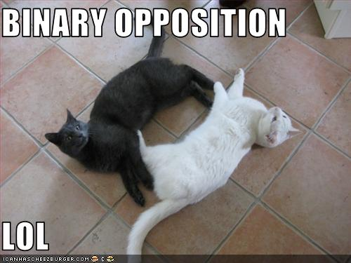
Binary oppositions
Protection of the physical environment OR technological & financial progress;
Should we obey the laws of the state if we consider they oppose ethical / humanitarian laws?
Disobedience to state laws should always be criticized negatively?
Under what (pre)conditions can we break the law?
Do we really bear responsibility for our actions in case we follow orders? How free is an executive to express her/his own views?
Can she/he act against the orders, knowing that there will be consequences? Is it fair to break the order and pay the cost?

Slide 6
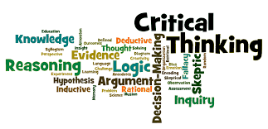
Dialectical Method techniques
Any ideas?

Slide 7
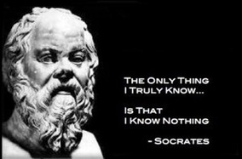
Dialectical method
Where do you stand on the line?
Silent discussion
Individual work
In the shoes of the other
Definitions of terms
Essential questions
The 5 whys / the Wh… questions
Questions with the notion of Time
Imagine the impossible
Two truths and one lie

Slide 8
Dialectical method
Definitions
Definition of ethics
A. ethics plural in form but singular or plural in construction : the discipline dealing with what is good and bad and with moral duty and obligation
2a : a set of moral principles : a theory or system of moral values the present-day materialistic ethic, an old-fashioned work ethic —often used in plural but singular or plural in construction an elaborate ethics, Christian ethics
B. ethics plural in form but singular or plural in construction : the principles of conduct governing an individual or a group professional ethics
c : a guiding philosophy
d : a consciousness of moral importance forges a conservation ethic
C. ethics plural : a set of moral issues or aspects (such as rightness) debated the ethics of human cloning

Slide 9
Definitions ETHICS vs MORALS: Is there a difference?
Ethics vs Morals : Is there a difference?
Ethics and morals are both used in the plural and are often regarded as synonyms, but there is some distinction in how they are used.
Morals often describe one's particular values concerning what is right and what is wrong:
It would go against my morals to help you cheat on the test.
He appears to see himself as a kind of cultural warrior, striking out against the crumbling morals of modern society.
While ethics can refer broadly to moral principles, one often sees it applied to questions of correct behavior within a relatively narrow area of activity:
Our class had a debate over the ethics of genetic testing.
Anyone, it seemed, could make the music -- if they couldn't play guitar, they could push a button -- and nobody worried about the ethics of appropriating riffs.
In addition, morals usually connotes an element of subjective preference, while ethics tends to suggest aspects of universal fairness and the question of whether or not an action is responsible:
Perhaps you don't like Kim Kardashian, or her family, or her morals don't align with yours, or you just think it's weird that she might have had some plastic surgery, likes to apply makeup in a really complicated way and named her kid “Saint.”
The Frenches, both professors in The Media School, focused on the ethics of making medical decisions for a child who could not express her own wishes yet...
DI

Slide 10
Dialectical Methods
ASK: WHO? WHO? WHAT? WHEN? WHERE? WHAT FOR?
ASK USING THE NOTION OF TIME : …in the past? ...in the future? Always? When exactly?
ASK: WHY? Or better…
ASK: The 5 whys
Example: The factory pollutes the river .
Why? Because they throw their garbage.
Why? Because they don't pay a fine.
Why? There is no law for such crimes.
Why? No one has asked to create a new law
Why? The citizens think they cannot ask such a thing.

Slide 11

Imagine tomorrow-IMAGINE THE IMPOSSIBLE
What does the impossible solution to the problem look like in practice?
What would things be like if they got worse before they got better?
What would the world be like if we made this happen?
What would it take to create a global solution?
How would our mindsets need to shift to create a change for the better?

Slide 12
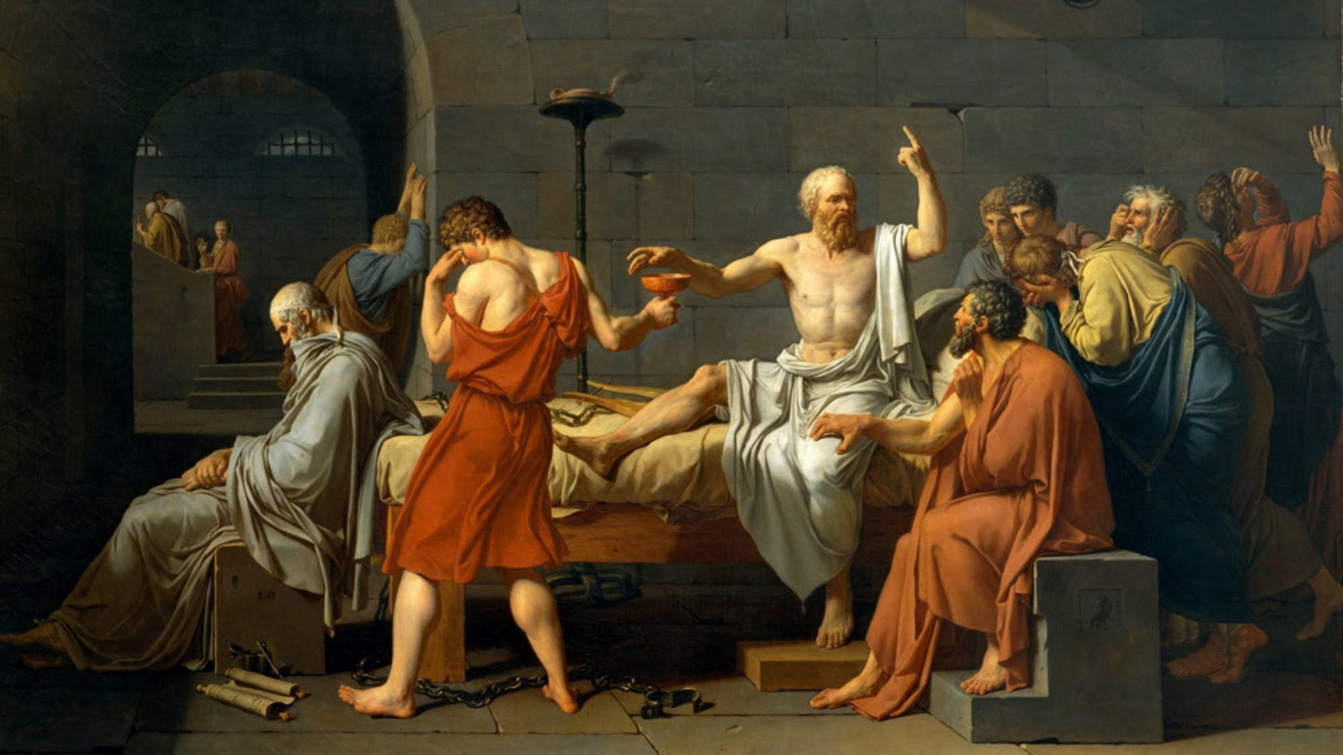
Dialectical Method – Essential questions
Example: Essential questions about the concept of "Law"
• What is the law?
• Who makes the laws?
• How are laws born?
• Why do laws change?
• What are the laws for?
• Are there societies without laws?
• Does the "jungle society" have no rules and laws?
• Are there societies with unjust laws?
• Are there societies with arbitrary laws?
• Law and freedom, opposite concepts?
• Law and democracy, identical concepts?
• The laws, good for the strong or for the weak?
• Do laws give me rights?
• Are the laws oppressive? To whom?
• Are the laws unfair? To whom?
• Why do we have to obey the laws?
• What are the unwritten laws?

Slide 13

Think about your interaction
Did you have the answer yourselves?
How did you try to persuade the other?
How did the other tried to persuade you?
Did you move from your personal opinion at the end?
Other thoughts?

Slide 14

Any new ideas about dialogue and dialectics?

Slide 15

Dialectics is NOT:
Debate, where opposing arguments are put forward to argue for opposing viewpoints.
Debate occurs in public meetings, academic institutions, and legislative assemblies. It is a formal type of discussion, often with a moderator and an audience, in addition to the debate participants.
Logical consistency, factual accuracy but also subjective elements and some degree of emotional appeal to the audience are elements in debating
where one side often prevails over the other party by presenting a superior "context" or framework of the issue.

Slide 16

Dialogue vs. Debate
Dialogue - multiple sides working towards a shared understanding
Dialog - listens to find common understanding
Dialog - enlarges and potentially changes a participants point of view
Dialog – One searches for strengths in all views
Dialog – remains open-ended
Debate - two sides trying to prove each other wrong
Debate - listens to find flaws
Debate - reaffirms a pre-held point of view
Debate – one searches for weaknesses in others' views
Debate – demands a conclusion

Slide 17
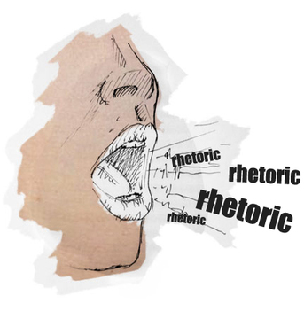
Dialectics is NOT:
Rhetoric. This is characterized by monologue, the person does not express his own beliefs and the truth of the speaker, and it is not in line with the speaker's actual life.
Moreover, rhetoric addresses an audience and not a subject that is in dialogue.
Rhetoric uses cheating techniques (lie, flattery, emotional dependence, rhetorical forms) to dominate and to direct the mind and the actions of the listeners, to convince and persuade.
"it offers belief with no knowledge, and does not teach on right and wrong" (Plato, Gorgias461 e,487a-e).

Slide 18
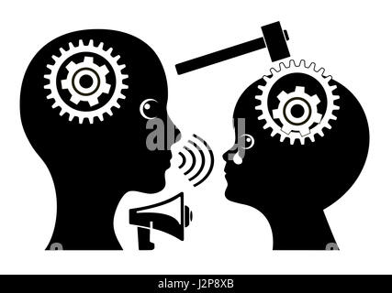
Dialectics is NOT:
A didactic method didáskein , "to teach") , wherein one side of the conversation teaches the other
that follows a consistent scientific approach or educational style to present information to students
This theory might be contrasted also with open/experiential learning , in which people can learn by themselves, in an unstructured manner, on topics of interest.

Slide 19
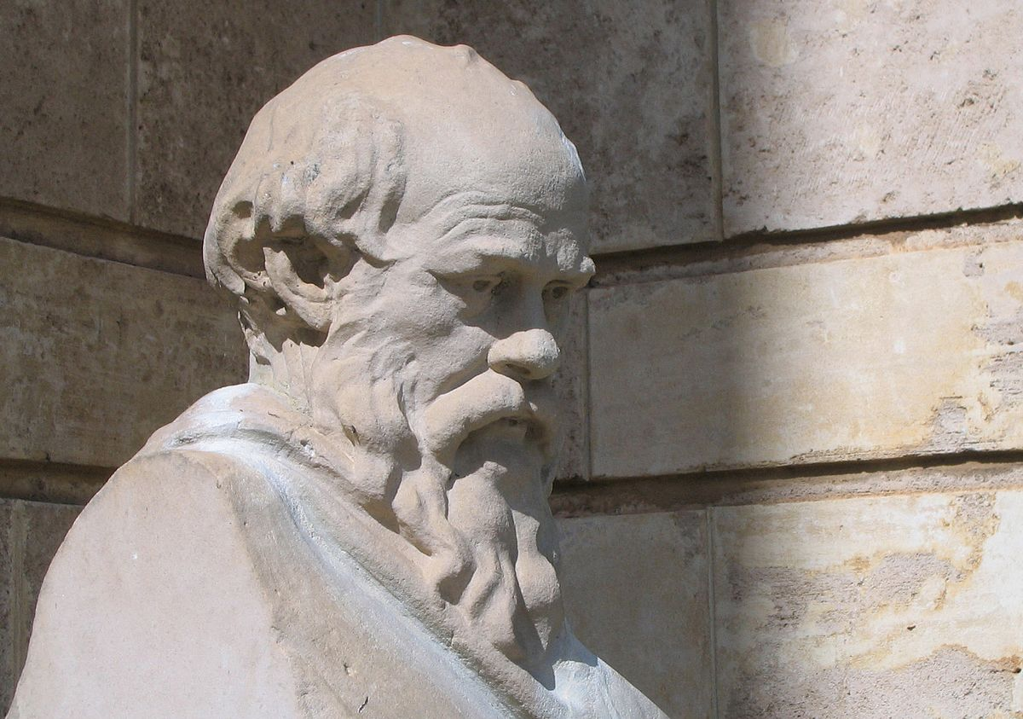
The dialectical method
Dialectic or dialectics (Greek: δι αλεκτική , dialektikḗ ), also known as the dialectical method , is a discourse between two or more people holding different points of view about a subject, but wishing to establish the truth through reasoned arguments.
dia -/ dia -: inter, between, among
Socrates: Classical Greek philosopher who developed a “Theory of Knowledge”.
Based on a form of inquiry and discussion between individuals, based on asking and answering questions to stimulate critical thinking.

Slide 20
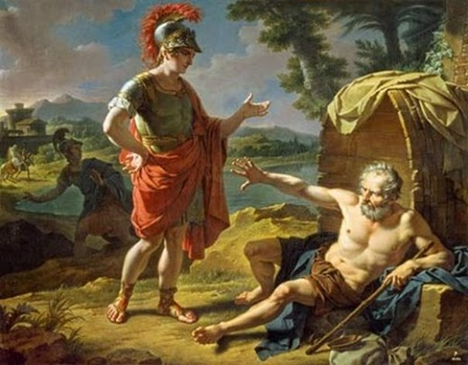
PARRHESIA related to Dialogue
Dialogue =I speak freely with/ to someone about something/ someone (Plato, Gorgias.491, Lachesis.178A, Charmidis.151A)
Through parrhesia ( parrhesia<pan +verb: I speak, I express everything ) = free expression of opinion, courage and clear expression of thoughts

Slide 21
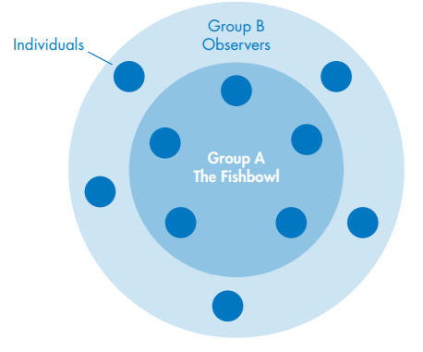
Dialectical Method techniques
Fish bowl
https://www.youtube.com/watch?v=sB143EA1ZGU

Slide 22
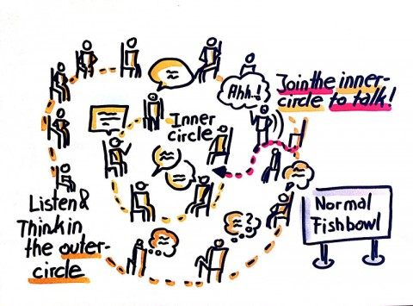
Fish bowl conversation technique
a smaller group (ideally 3 – 6 people) is isolated to discuss while
the rest of the participants (maximum of 50 people) sit around the outside and observe without interrupting
the inner circle is assigned roles and
the outer circle provides feedback
An observer can join the inner cycle when she/he wants, and the others have to listen to her/him first
At the end: first the inner cycle reports, then the outer cycle gives feedback
EXAMPLE: should children between 10-13 have the COVID vaccine now?

Slide 23

Fish bowl - How was your experience?
first the inner cycle reports
then the outer cycle gives feedback
Conclusions on the technique
Conclusions on the topic
IF

Slide 24
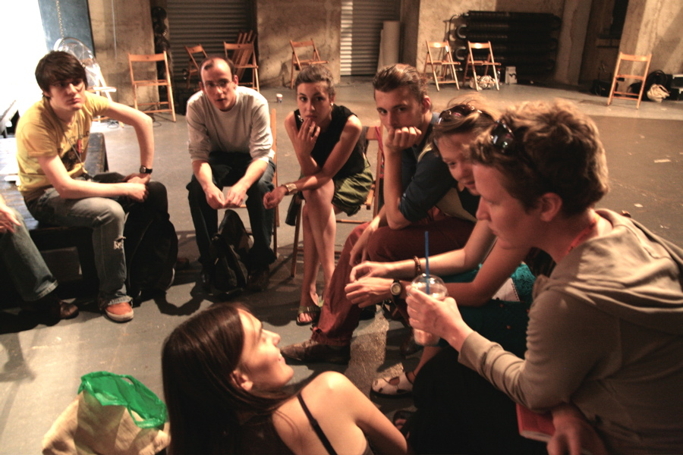
What to point out in Fish bowl
The outer cycle switch off the cameras+ mic
Each person has 1 min, max 2 each time she/he speaks
Silence in the beginning to construct our opinions
The arguments should be concrete and not repeated
Examples should be presented
Collective role: all persons of one opinion present in the beginning
The outer cycle could intervene, enter the inner cycle (even replace them)

Slide 25
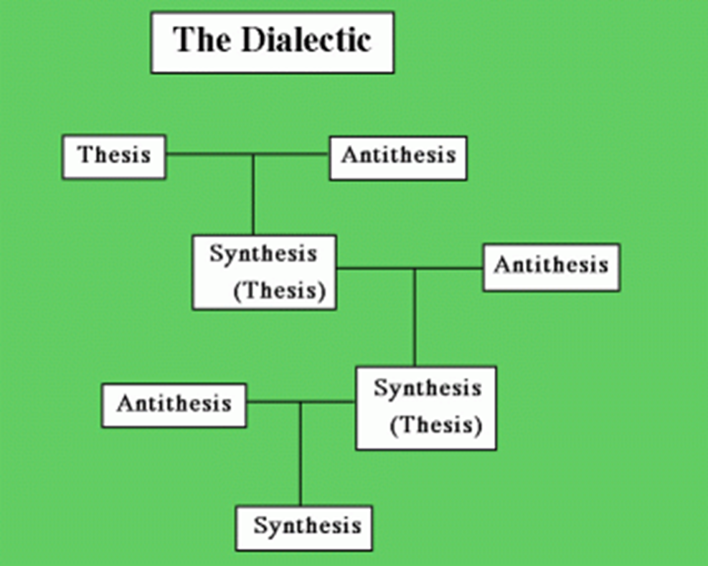
Dialectics in three stages of development
(1) thesis : a beginning proposition
(2) antithesis : a negation of that thesis
(3) synthesis : the two conflicting ideas are reconciled to form a new proposition
Notes:
Dialectic comprises three stages of development: first, a thesis or statement of an idea, which gives rise to a second step, a reaction or antithesis that contradicts or negates the thesis, and third, the synthesis, a statement through which the differences between the two points are resolved.

Slide 26
The EAR methodology and its steps (1)
Warm –up - where the learners react to one of the topics, and the facilitator checks their interest, involvement and prior knowledge on the topic. This can be done through the presentation of a concept, a poem, a music, a painting, a newspaper article, a text of literature, a photo, a letter, a diary, an object, a song, a video, a still image and other stimuli. Each learner thinks and/or writes her/his view and feelings on the topic, the main term or the main question(s). The learners' first reactions are explored.
The main concept(s)- where learners analyze and define further the main concept(s) or problem(s), based on questions, definitions from the dictionary etc., and they try to find the real meaning of the concept(s) in different contexts
Theater techniques – where they explore the topic through experiential theatrical activities of different kind, whether it is Forum Theatre, Documentary Theater or Participatory Theatre. Debriefing should follow - where learners step outside their roles as actors and discuss how they felt and how they feel now and what they think.

Slide 27
The EAR methodology and its steps (2)
4. Dialectical Discussion - where learners develop critical thinking skills. They create a discussion upon the Dialectics principles and not just a guided conversation or a debate where two groups will cross swords on a binary opposition. Individual and group work - where every learner will think and possibly write about what s/he believes on a topic, what are the arguments to base her/his opinion on, why s/he has this view, which are the factors affecting what s /he believes today. Learners present and explain their opinion to the others and they answer questions that are relevant and based more on the "aporia". Learners become self-directed and autonomous learners and research
5. Personalized Action plan - where learners record their feelings and opinions now, and create their personal or group action plan with short-term, medium-term and long-term measures

Slide 28

Theatre and drama techniques
Forum Theatre
Documentary Theatre
Invisible theatre
Documentary theatre
Verbatim theatre
…

Slide 29
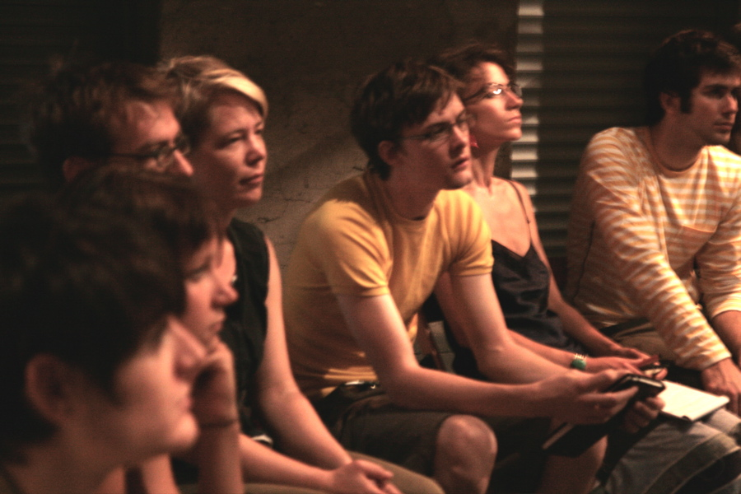
Philosophy and Politics in Socrates
The objective of Philosophy is identical to the objective of Politics:
To develop autonomous citizens in autonomous societies
Acting (praxis) is dialectically connected to the continuous change of the person who acts
The concept of Citizen refers to the ethical personal stance towards others, the City, the Laws and the Institutions ( citizen citizen =/= idiot private person )
Parrhesia is a unique means to political action
Harmony between what we say and what we do, how we live
Notes:
PHILOSOPHY desire for wisdom and truth, for encounter with the Other, ACTIVE CITIZEN
A CITIZEN chooses truth over falsehood or silence, insecurity, condemnation over safety, criticism over demagoguery, moral duty over apathy DEBT OR PARRISIA

Slide 30
Action planning is necassary
Dialectics=Theory + Action/ Praxis
How can I gain more knowledge on this topic?
How can I develop my skills to think and act on this topic?
How can I change my attitude or my behavior , when I believe something is not right?
What else can I do to change the social context on this?
HOW CAN I THINK IN A DIALECTICAL WAY AND ACT AS AN ACTIVE CITIZEN?
IF

