Slide 1
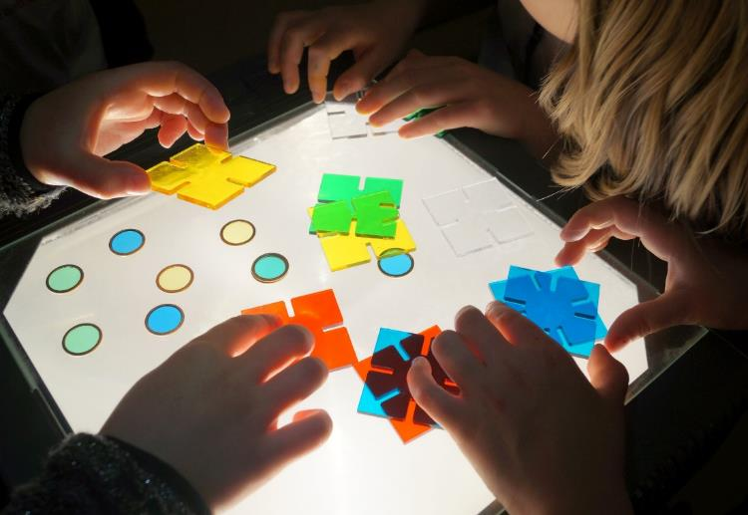
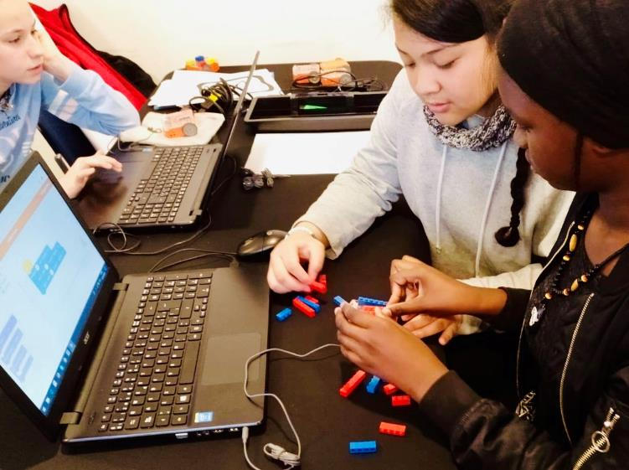
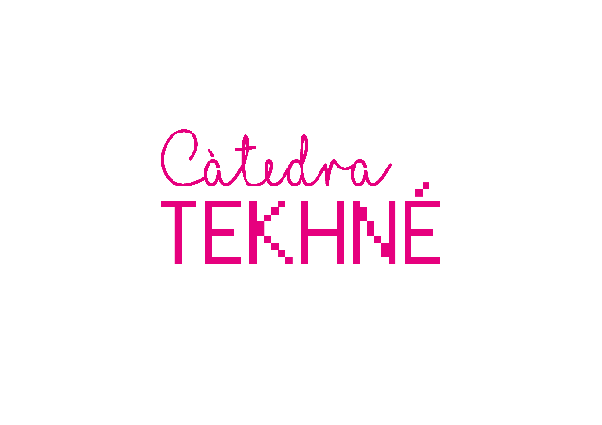


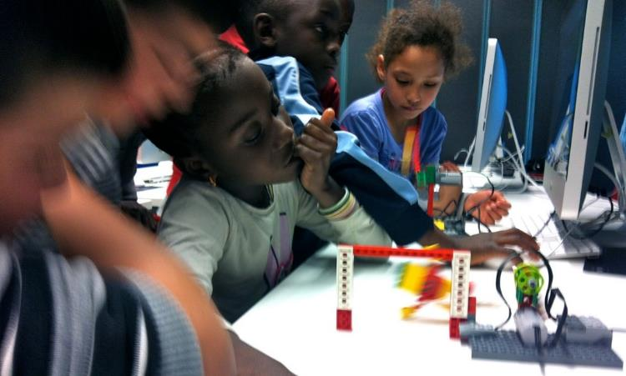
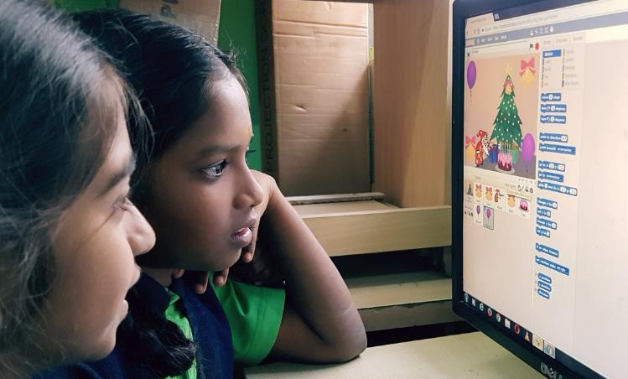

Slide 2
Digital Storytelling
With Scratch

Slide 3
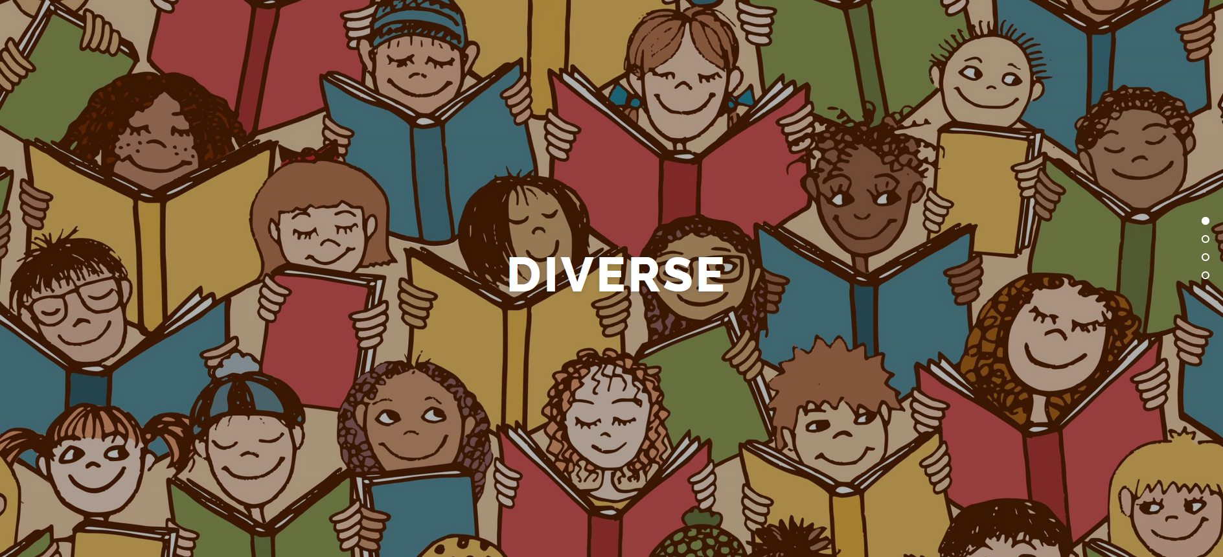
Project DIVERSE (Erasmus+) 2019-2021
http://diverse-education.eu/
Methods:
- Folk Tales
- Drama in Education
- Digital Storytelling

Slide 4
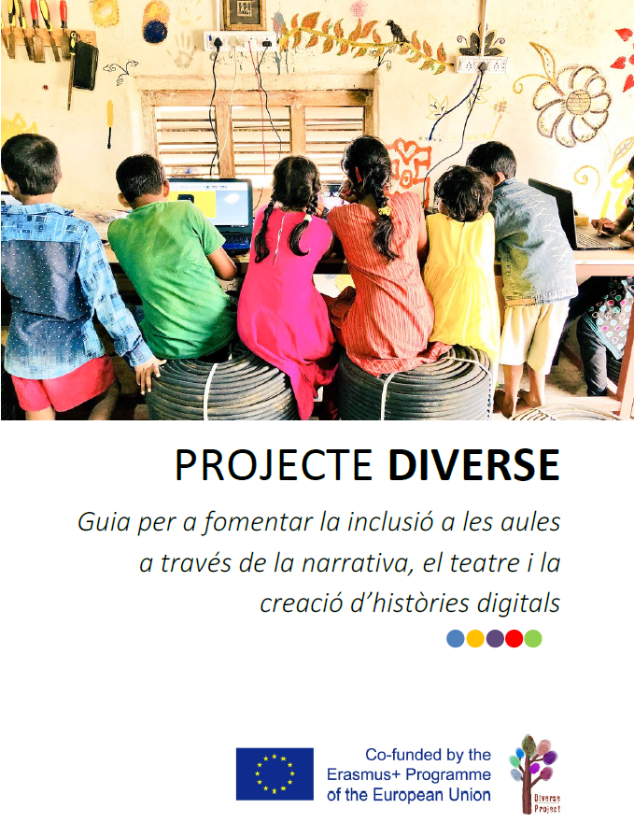
Project DIVERSE (Erasmus+) 2019-2021
Guidance book
for Teachers
http://diverse-education.eu/guidance-book/

Slide 5
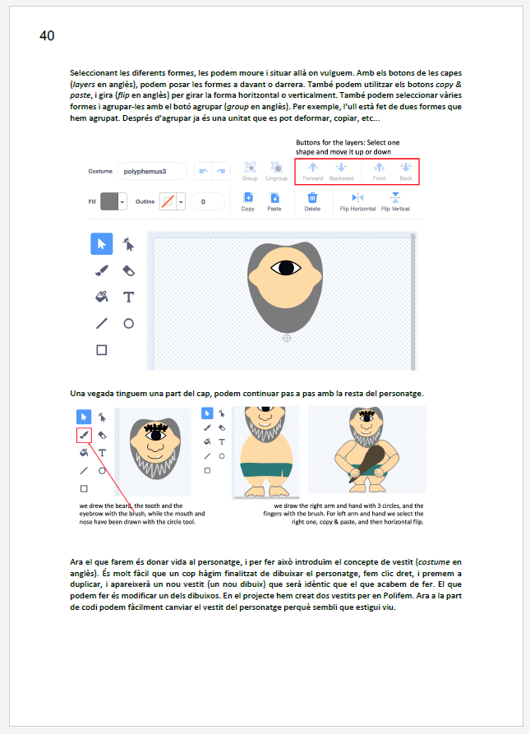
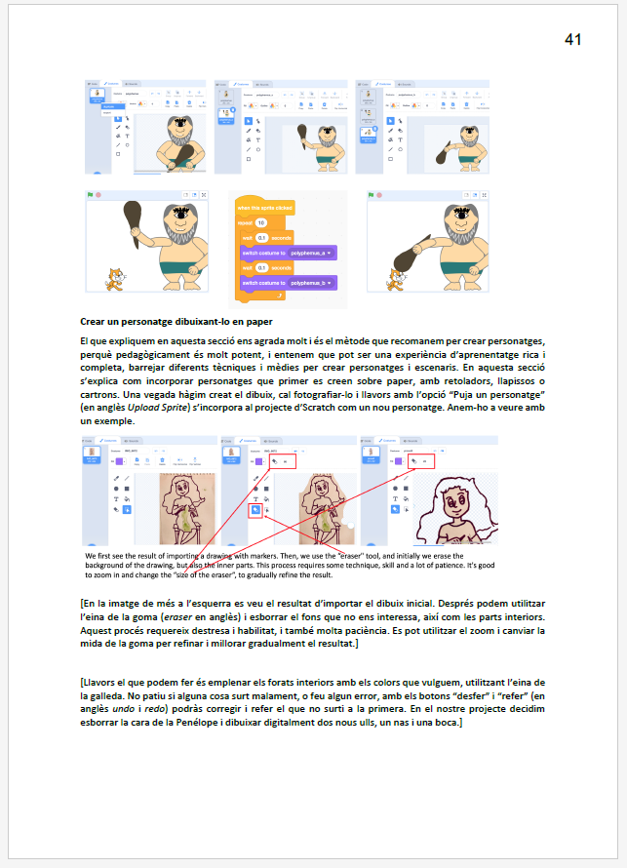
Project DIVERSE (Erasmus+) 2019-2021
http://diverse-education.eu/guidance-book/

Slide 6
0. Context (5 min)
1. Why Digital Storytelling? (10 min)
2. Why Scratch? (20 min)
3. Scratch Tutorial (40 min)
4. Open questions (15 min)

Slide 7
1. Why Digital Storytelling?

Slide 8
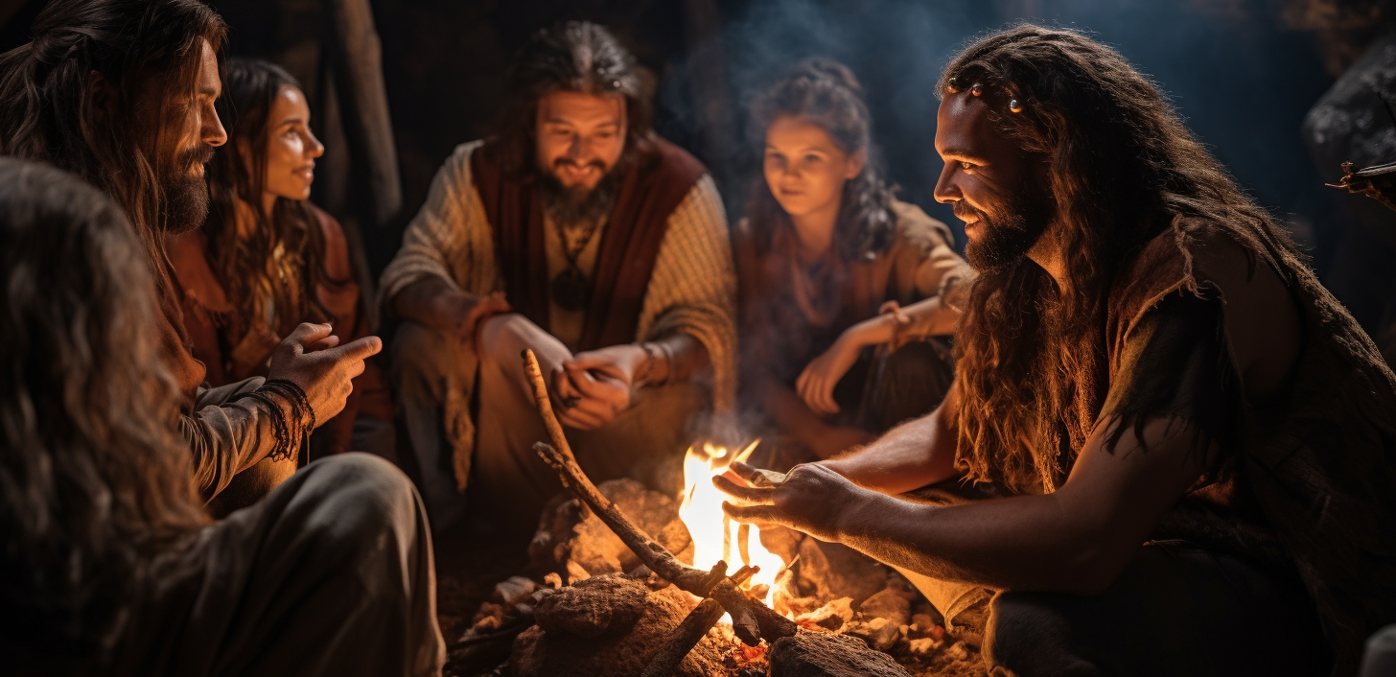
Since the dawn of civilization, humans have needed to share and connect through stories.
Stories transcends mere entertainment; they are a profound expression of our desire to understand and be understood. Stories serve as bridges, linking us across generations, cultures, and experiences. They give voice to our joys, sorrows, dreams, and fears…

Slide 9

What is storytelling?
The ancient art of conveying events in words, images, and sounds.
Why storytelling in Education?
Storytelling in education fosters engagement and deepens understanding by connecting lessons to relatable human experiences.
It harnesses the power of narrative to make abstract concepts memorable and to cultivate critical thinking and creativity in students.

Slide 10
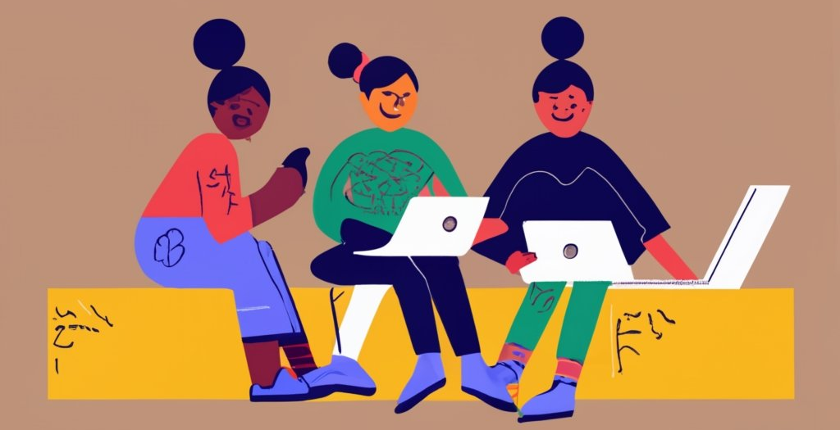
What makes storytelling digital?
Use of digital tools and platforms to tell stories.
Combines various forms of media – text, audio, video, and images.
Multimedia Storytelling: Multiple forms of media — text, audio, video, graphics, and more — within a single narrative platform.
Transmedia Storytelling: Involves telling a story or a narrative across multiple platforms and formats using current digital technologies.

Slide 11
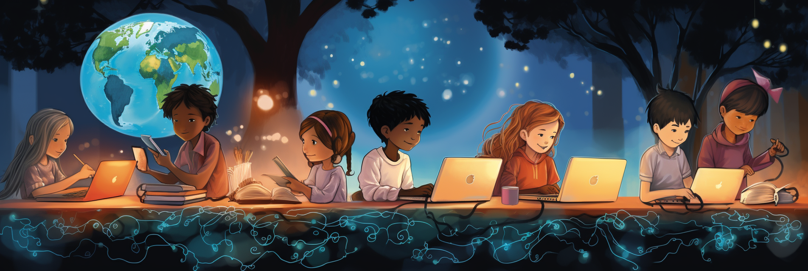
Benefits of Digital Storytelling in Education
Engagement (Multisensory Experience, Interactivity, Dynamic Content…)
Creativity: Digital tools provide a plethora of ways to express oneself.
Critical Thinking: Planning a narrative requires organized thought.
Technical Skills: Familiarity with modern digital tools.
…

Slide 12
2. Why Scratch?

Slide 13
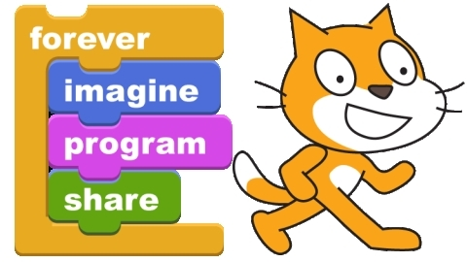
scratch.mit.edu
Notes:
LEMA INSPIRADOR…
LOGOTIP
A CONTINUACIÓ, I ABANS D’ENTRAR EN DETALLS DELS PROJECTES, US VULL MOSTRAR UNES POQUES TRANSPERENCIES AMB IMATGES I PARAULES CLAU DEL GRUPDE RECERCA

Slide 14
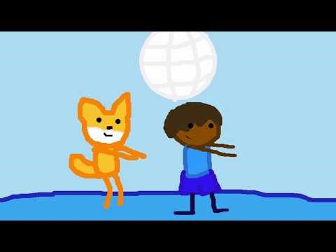
https://youtu.be/98awWpkx9UM

Slide 15
WHY SCRATCH?
  It's online and free, you don't need to install any special software to start creating.
  It is multiplatform, and works on computers as well as tablets and mobile phones.
  It is translated into many languages.
  It is designed with a very powerful pedagogical approach, and allows learning in a very intuitive way, facilitating self-learning and learning by discovery and exploration.
  It allows us to create digital stories, but also games, artistic projects, simulations, etc.
  It allows to share our creations on the Internet, in a very easy way, and also allows to remix the creations of others, which is a very powerful feature.
  It is not only a tool and an environment but also a huge community.
  Scratch has a low floor, high ceiling and wide walls.
  It has extensions that allow us to play with music, give voice to our characters (recording or text-to-speech), connect the story on our screen with the outside world (sensors, robots, etc.).

Slide 16
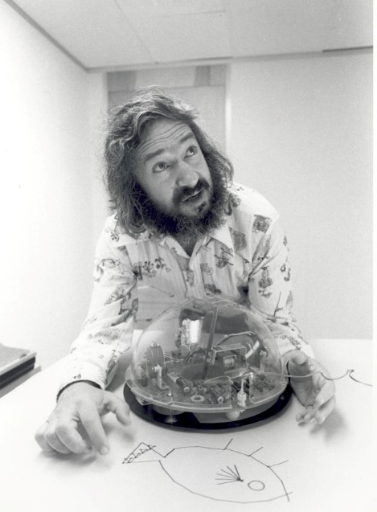
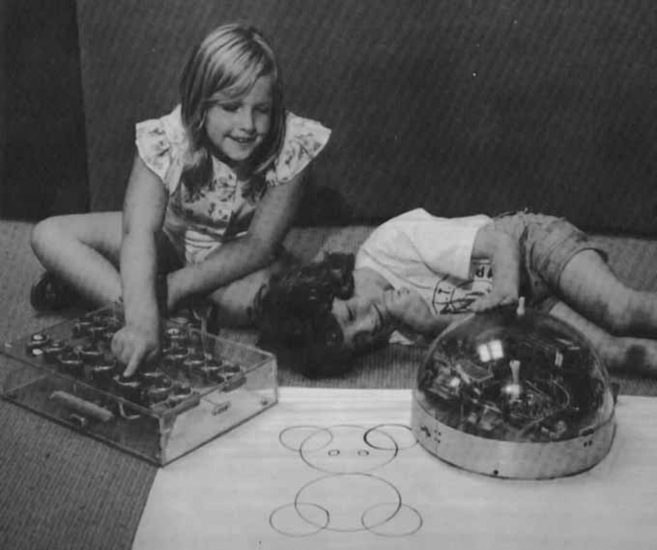

Slide 17
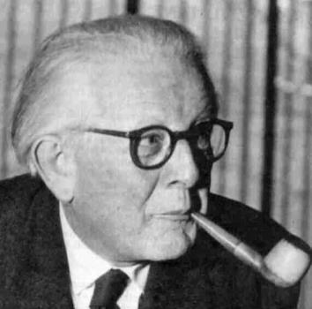
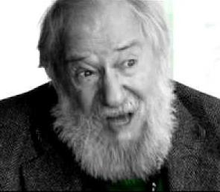
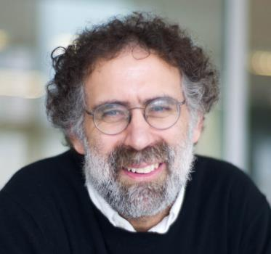
J. Piaget (1896-1980)
S. Papert (1928-2016)
M. Resnick (1956)
Constructivism
Constructionism
Humans construct their knowledge especially well when they participate in the construction of “artifacts” that are personally meaningful to them.
Constructing knowledge in our mind while building something with our hands.
Knowledge acquisition is a process of continuous self-construction. The child builds his/her knowledge with what is meaningful to him/her, making a process of assimilation of what is new with respect to what he/she already knows.
Computer as a tool for constructing knowledge and a médium of self-expression

Slide 18
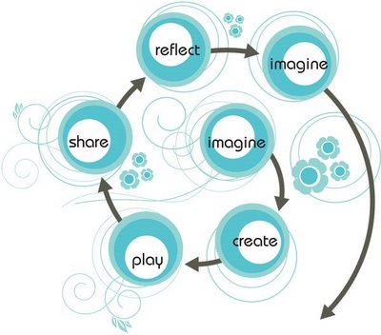



Slide 19
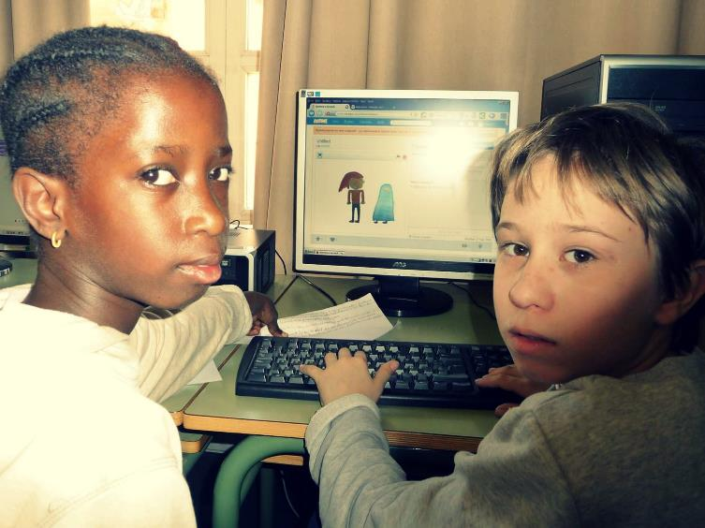
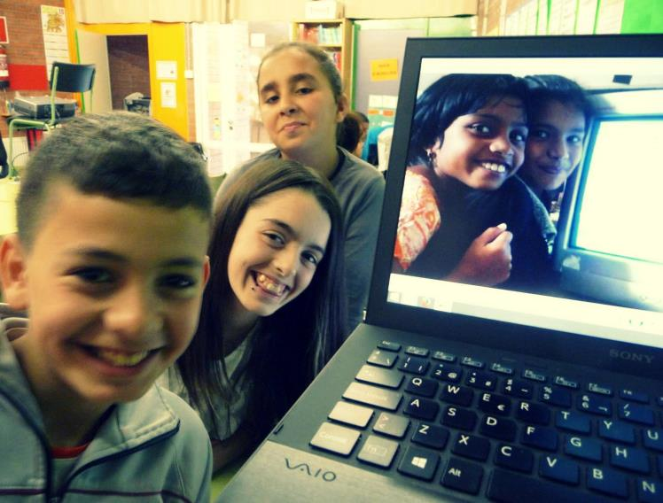
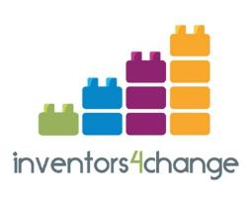
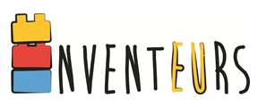

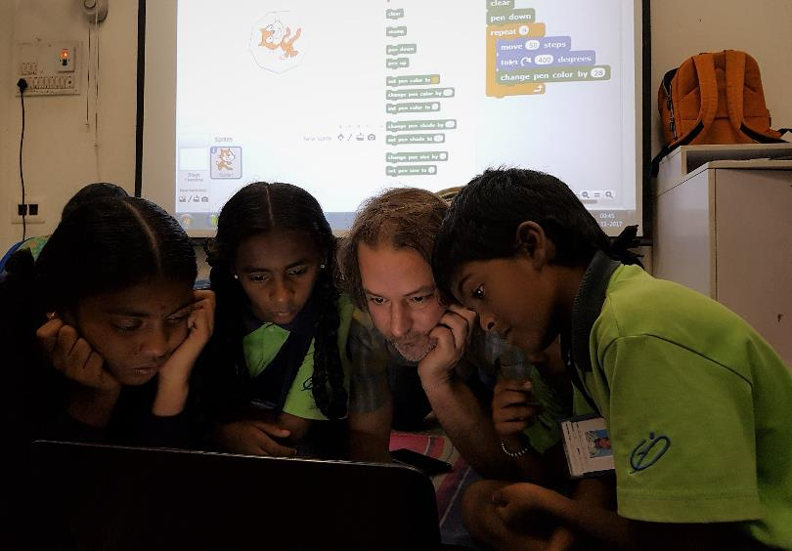
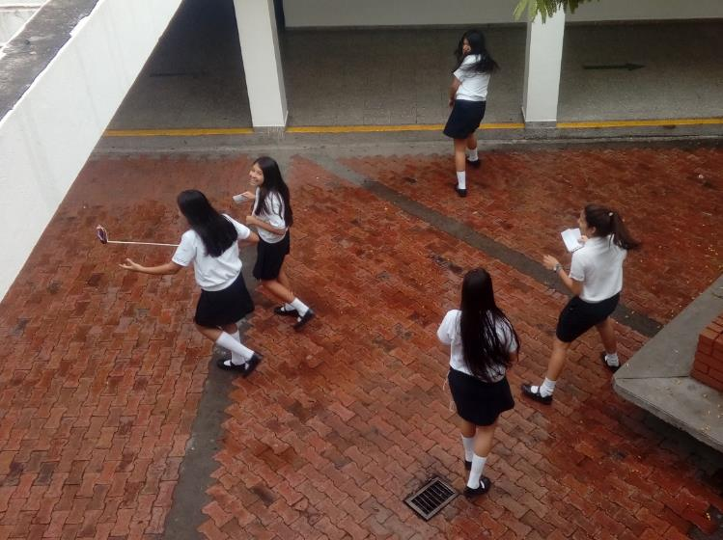

Slide 20
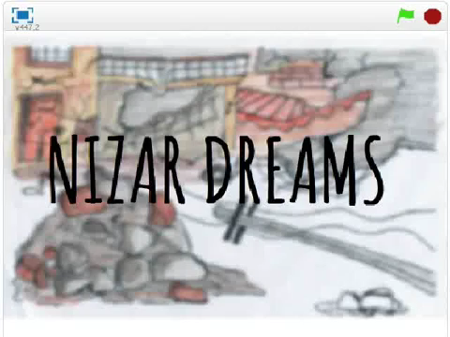

Slide 21
3. Scratch Tutorial

