Slide 1

CREATIVE METHOD
Game Based Learning
G
A
M
E
UNIFI Team
Cristina GAGGIOLI, Claudia LAFRANCONI, Giulia CUOZZO
Maria RANIERI, Stefano CUOMO, Silvia MICHELETTA

Slide 2
G.A.M.E. is a tool aggregator that collects learning and game design tools already in use.
Teachers and educators can have at their disposal a summary of the main design elements related to inclusion and gamification.
G
A
M
E

Slide 3
GAME Model
Your class | G | A | M |  | E
 | Educational goals | Accessibility criteria for SEN students | Motivation | Game mechanics |  | Educational strategy | Evaluation

Slide 4
Are you ready to play with us?
Let's
do this!

Slide 5
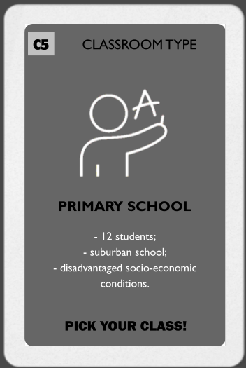
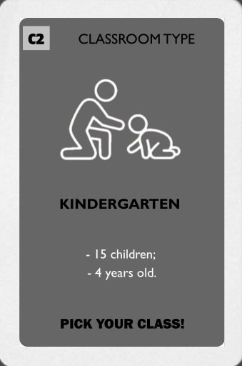
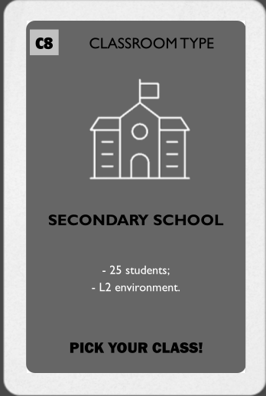
G
A
M
E
FIRST STEP: PICK YOUR CLASS!
Be careful, we have a lot of different classrooms here, pick your class and take care of all the characteristics of them!

Slide 6

GAME Model
Your class | G | A | M |  | E
 | Educational goals | Accessibility criteria for SEN students | Motivation | Game mechanics |  | Educational strategy | Evaluation

Slide 7






DANGER!! WHAT’S THAT?
G
A
M
E

Slide 8
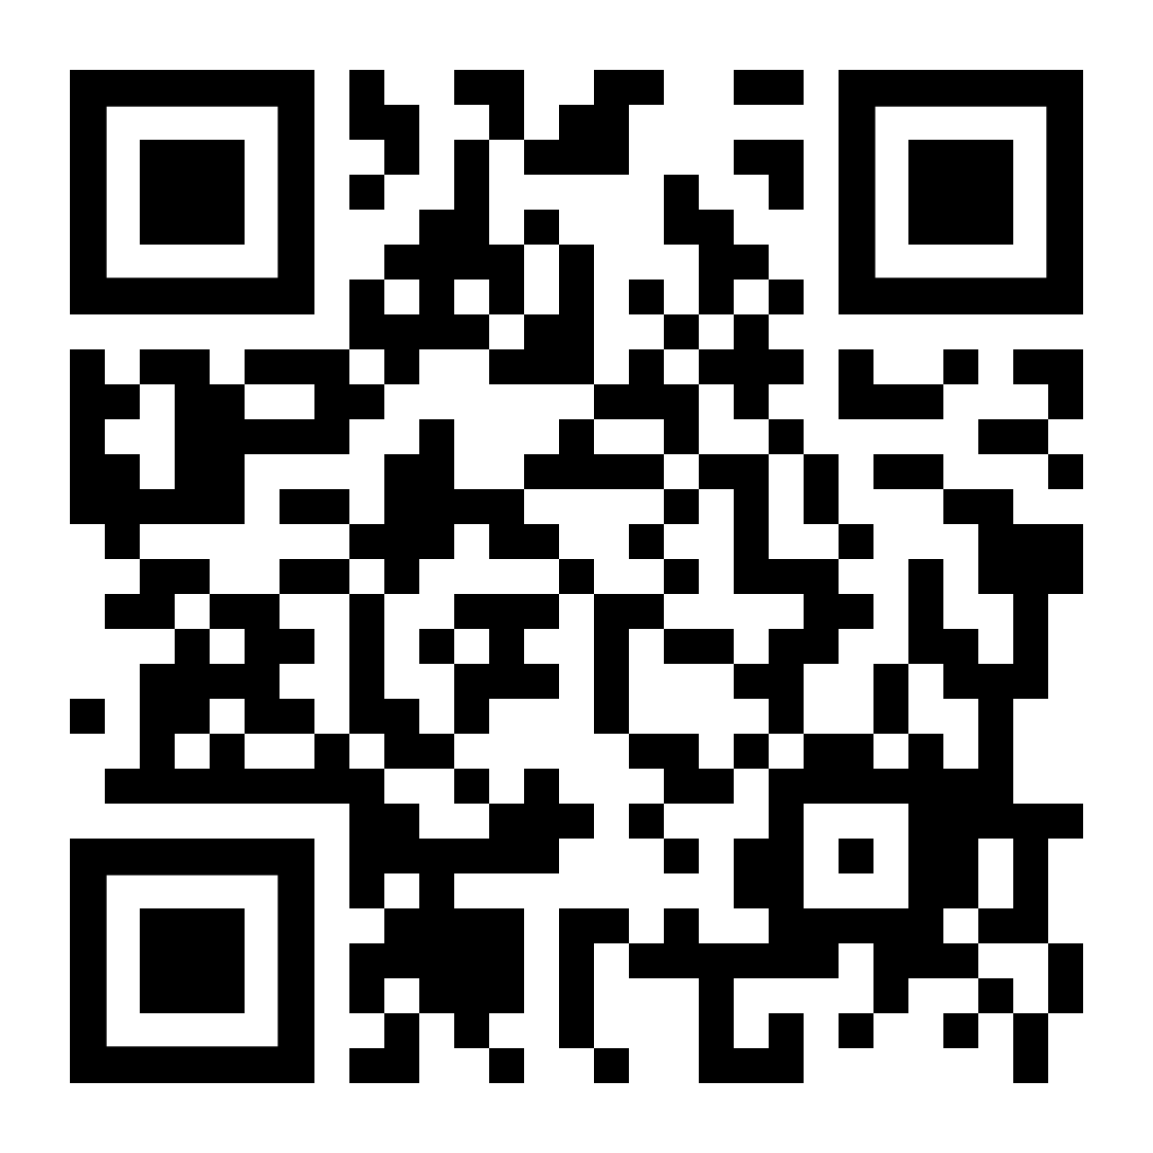
G
A
Share your opinion with us!
M
E

Slide 9
DANGER!! WHAT’S THAT?
G
A
M
E
Learning disorders. ADHD (attention disorders)
Deafness
Blindness
Physical disability
Gifted, intellectual disabilities
Communication & language disorders

Slide 10

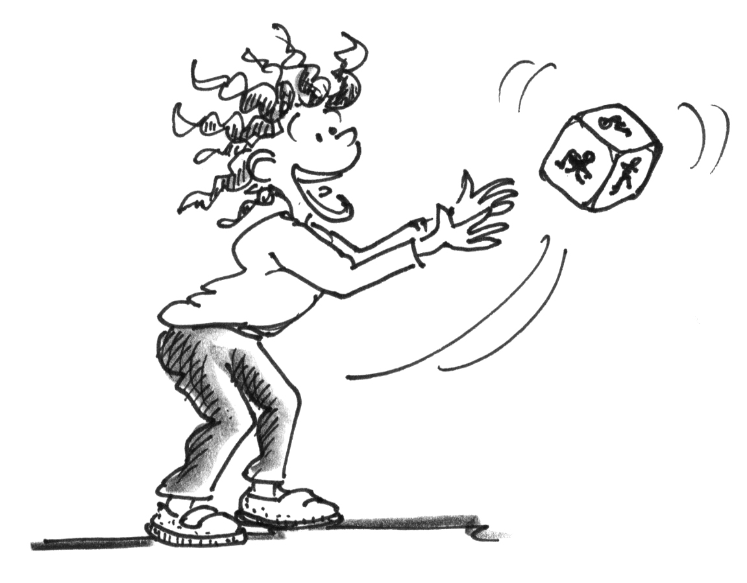
Roll the dice to find out what special educational need
you have in your classroom

Slide 11
GAME Model
Your class | G | A | M |  | E
 | Educational goals | Accessibility criteria for SEN students | Motivation | Game mechanics |  | Educational strategy | Evaluation

Slide 12
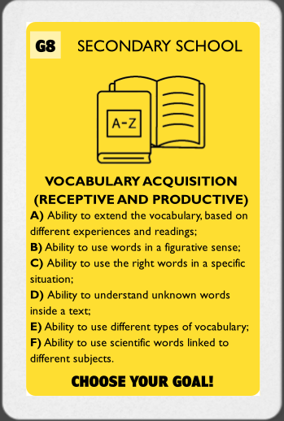
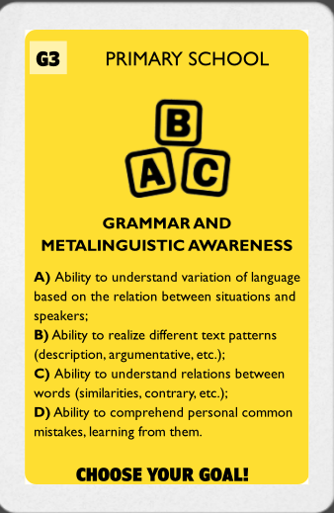
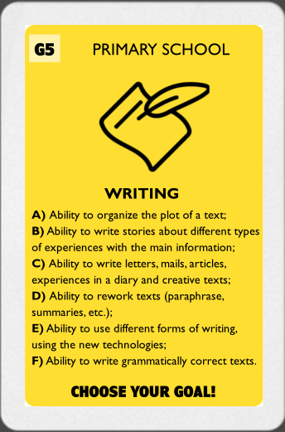
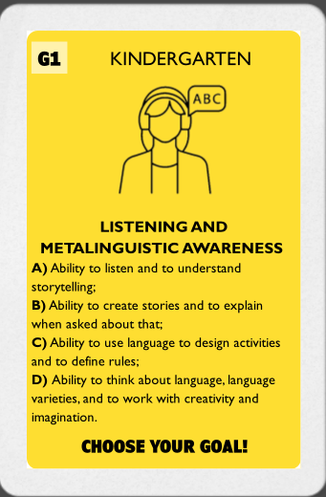
G
A
M
E
SECOND STEP: CHOOSE YOUR GOAL!
While picking up your card, look at the goals you have to achieve there: they are based on the National Directions for the curriculum for Kindergarten, Primary and Middle School.
An italian document through which teachers can decide the aim of every teaching session.

Slide 13
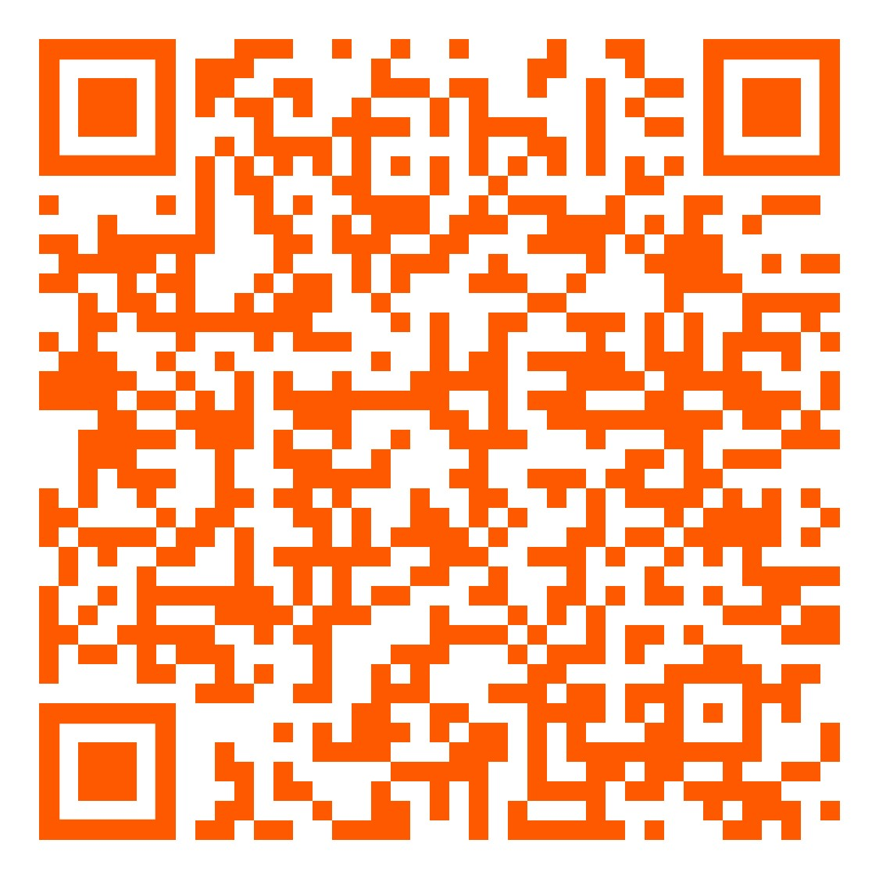
G
A
M
E
NATIONAL DIRECTIONS FOR CURRICULUM
It is an Italian document with the aim to relate culture, school and the single person, all of them jointed also to the principles of the Italian Constitution, and the European culture, giving importance to the individual diversities, asking students, as well as parents, to participate.
For more info scan the QRCODE!

Slide 14
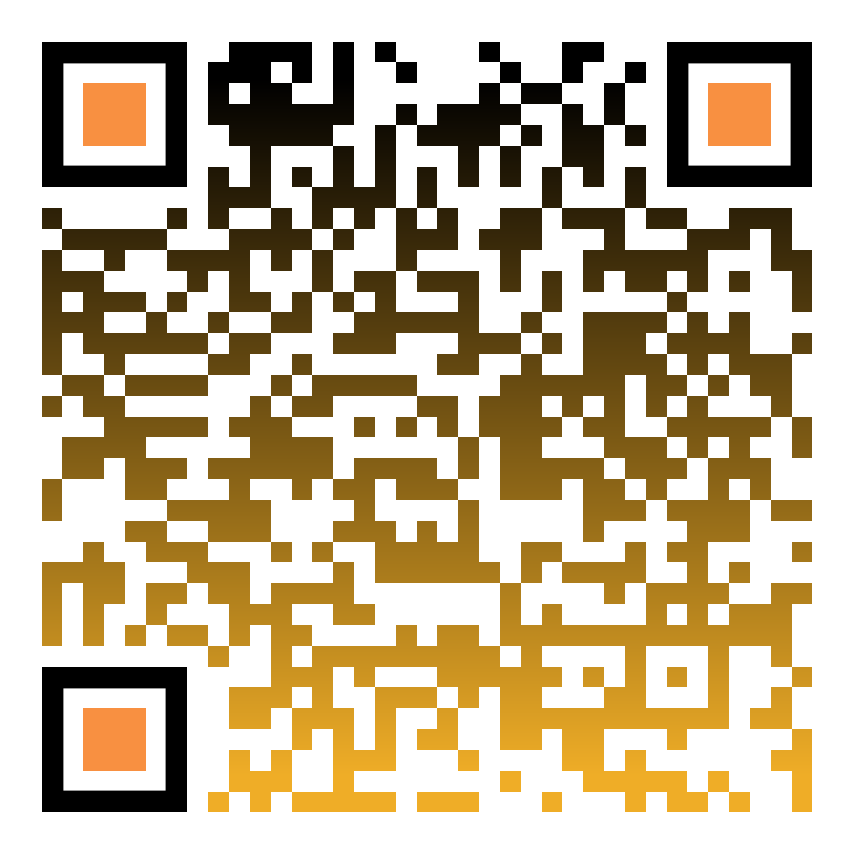
G
A
SECOND STEP: CHOOSE YOUR GOAL!
To do that, you have to remember and to know the IEP (INDIVIDUALIZED EDUCATIONAL PLAN):
This plan details an individualized support strategy to enable the student to reach their learning goals, because it is the “duty of the Italian Republic to remove any obstacles constraining the freedom and equality of citizens in order to ensure the full development of the human person” (Article 3).
In particular, Decree 66 on the inclusion of pupils with disabilities focuses on the school environment and enhances individual education plans (IEPs) for pupils, aimed at identifying barriers and facilitators in school life. Parents submit information about their children so schools can provide all the necessary support. In addition, families are eligible for other help, including financial support, according to the national health plan.
It aims to ensure an ever more welcoming school for pupils with disabilities, strengthening the role of families and associations in inclusion processes and involving – especially through in-service training – all the school staff.
M
E

Slide 15

G
SECOND STEP: CHOOSE YOUR GOAL!
The ADDIE model is the generic process traditionally used by instructional designers and training developers. The five phases—Analysis, Design, Development, Implementation, and Evaluation—represent a dynamic, flexible guideline for building effective training and performance support tools. While perhaps the most common design model, there are a number of weaknesses to the ADDIE model which have led to a number of spin-offs or variations.
A
M
E

Slide 16
G
A
M
E
SECOND STEP: CHOOSE YOUR GOAL!
While picking up your card, look at the goals you have to achieve there: they are based on the National Directions for the curriculum for Kindergarten, Primary and Middle School.
An italian document through which teachers can decide the aim of every teaching session.

Slide 17

G
Your class | G | A | M |  | E
 | Educational goals | Accessibility criteria for SEN students | Motivation | Game mechanics |  | Educational strategy | Evaluation

Slide 18
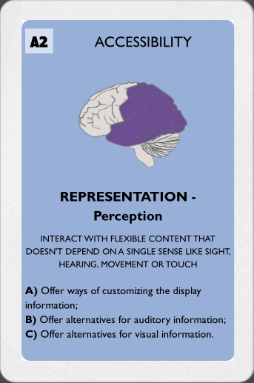

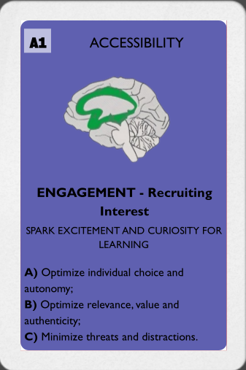
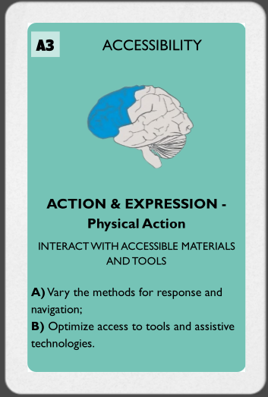
THIRD STEP: FIND OUT THE RIGHT ACCESSIBLE MODALITY
Based on the UNIVERSAL DESIGN FOR LEARNING (UDL), find out the perfect accessible modality for your goals.
A
G
M
E

Slide 19
A
Your class | G | A | M |  | E
 | Educational goals | Accessibility criteria for SEN students | Motivation | Game mechanics |  | Educational strategy | Evaluation

Slide 20
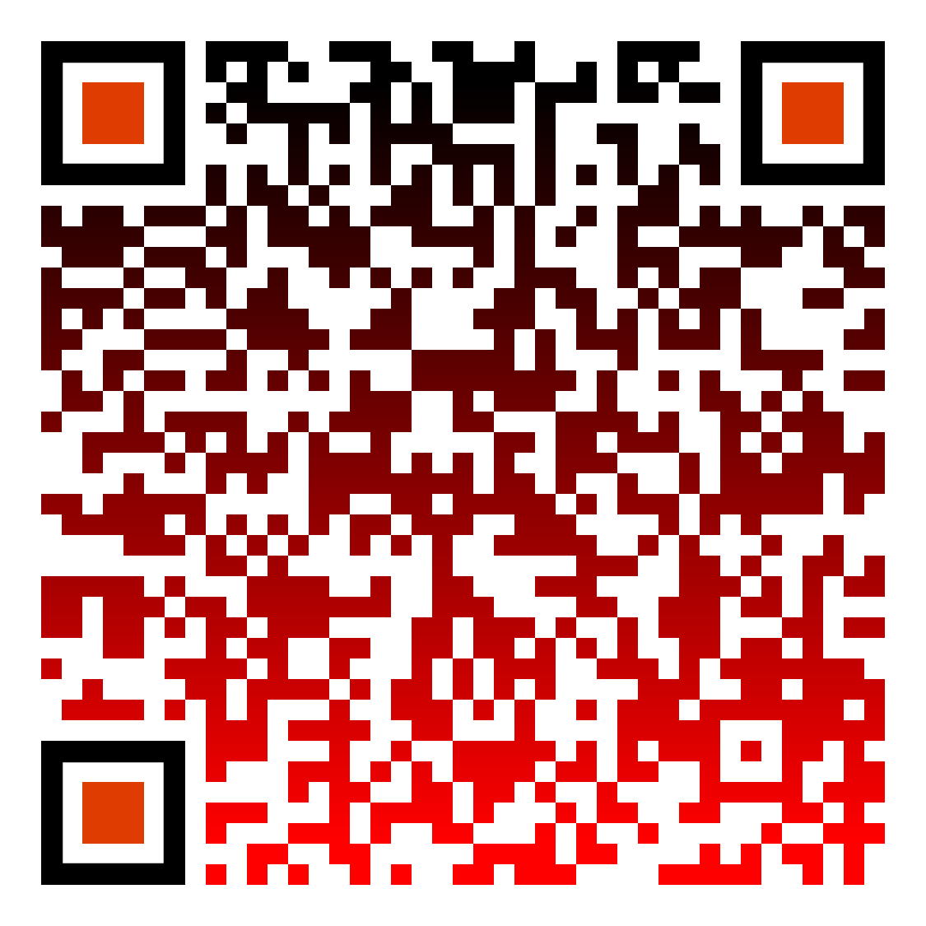
FOURTH STEP: LOOK FOR ALL THE POSSIBLE WAYS TO IMPROVE MOTIVATION
G
A
E
M
Into the Octalysis model, you have a lot of possibilities to improve motivation, through many different core drives, let’s find out which one suits you the most!

Slide 21
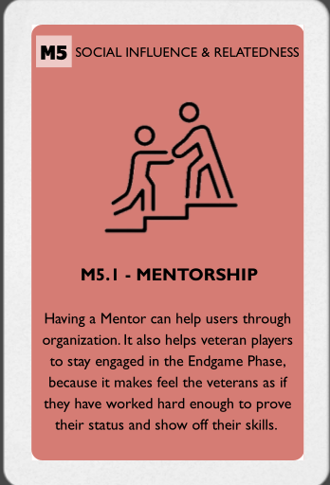
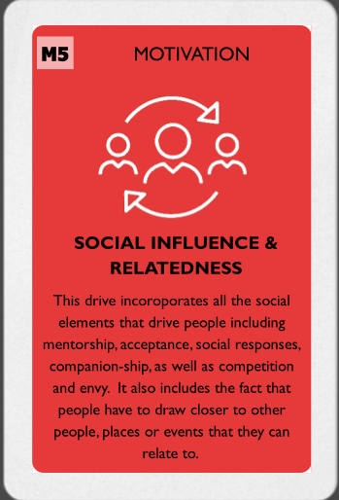
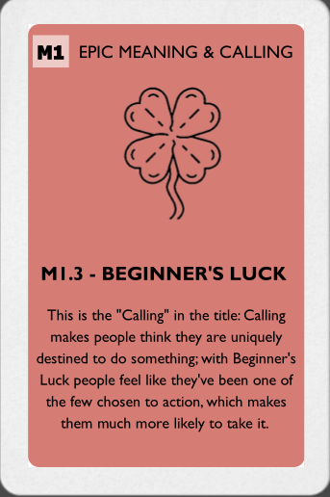
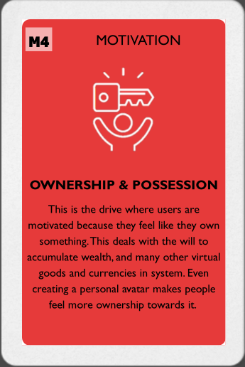
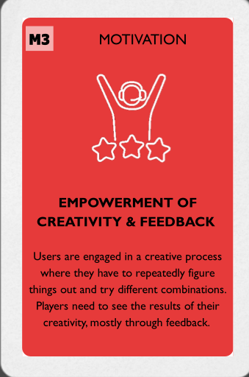
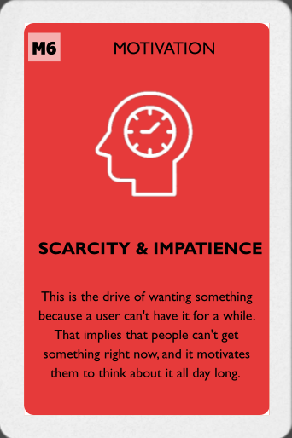
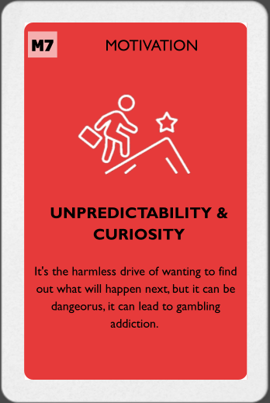
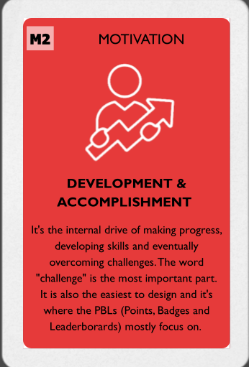
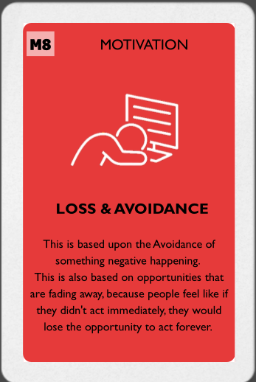
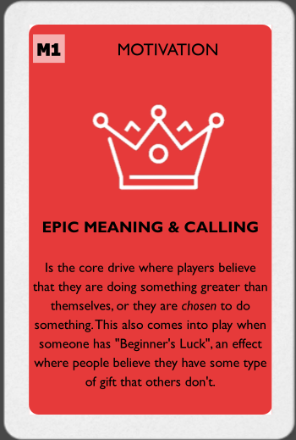
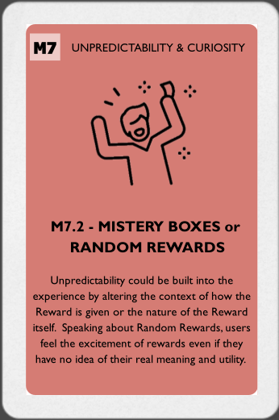
FOURTH STEP: LOOK FOR ALL THE POSSIBLE WAY TO IMPROVE MOTIVATION
G
A
E
M
Here you will find 8 core drives, the darker ones, in which you are going to find some methodologies. Choose your core drive first and then find out the mechanics that best suits you!

Slide 22
M
Your class | G | A | M |  | E
 | Educational goals | Accessibility criteria for SEN students | Motivation | Game mechanics |  | Educational strategy | Evaluation

Slide 23
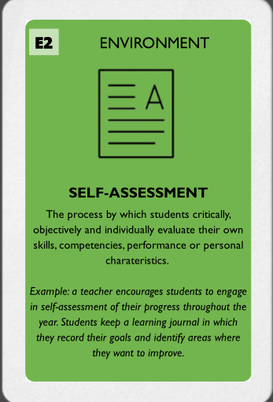
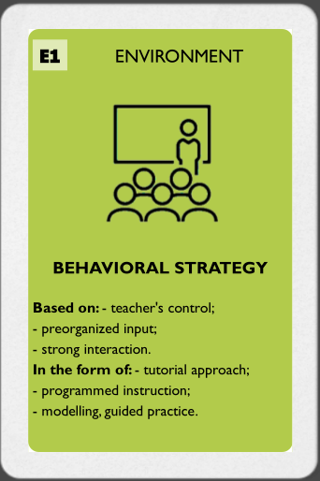
What’s your class like?
G
A
M
E
Speaking about the Environment, you will have to choose between different types of lessons.
After that you will also have to choose the type of evaluation you prefer, based on another type of card.

Slide 24
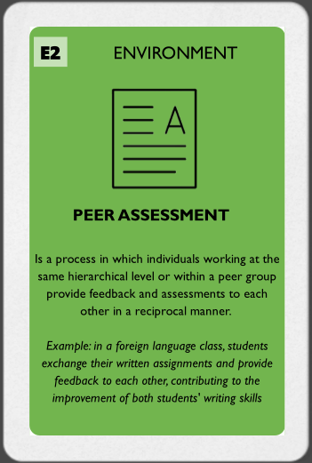
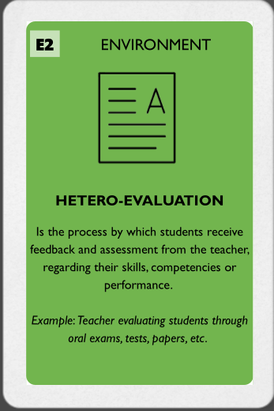
CHOOSE YOUR ASSESSMENT METHOD!
G
A
M
E

Slide 25
E
Your class | G | A | M |  | E
 | Educational goals | Accessibility criteria for SEN students | Motivation | Game mechanics |  | Educational strategy | Evaluation

Slide 26
G.A.M.E.
Microlearning | Goal | Accessibility | Motivation |  | Environment
 | Educational goals | Accessibility criteria for SEN students | Motivation | Game mechanics |  | Educational strategy | Evaluation
Discovery
Onboarding
Scaffolding
Endgame

Slide 27
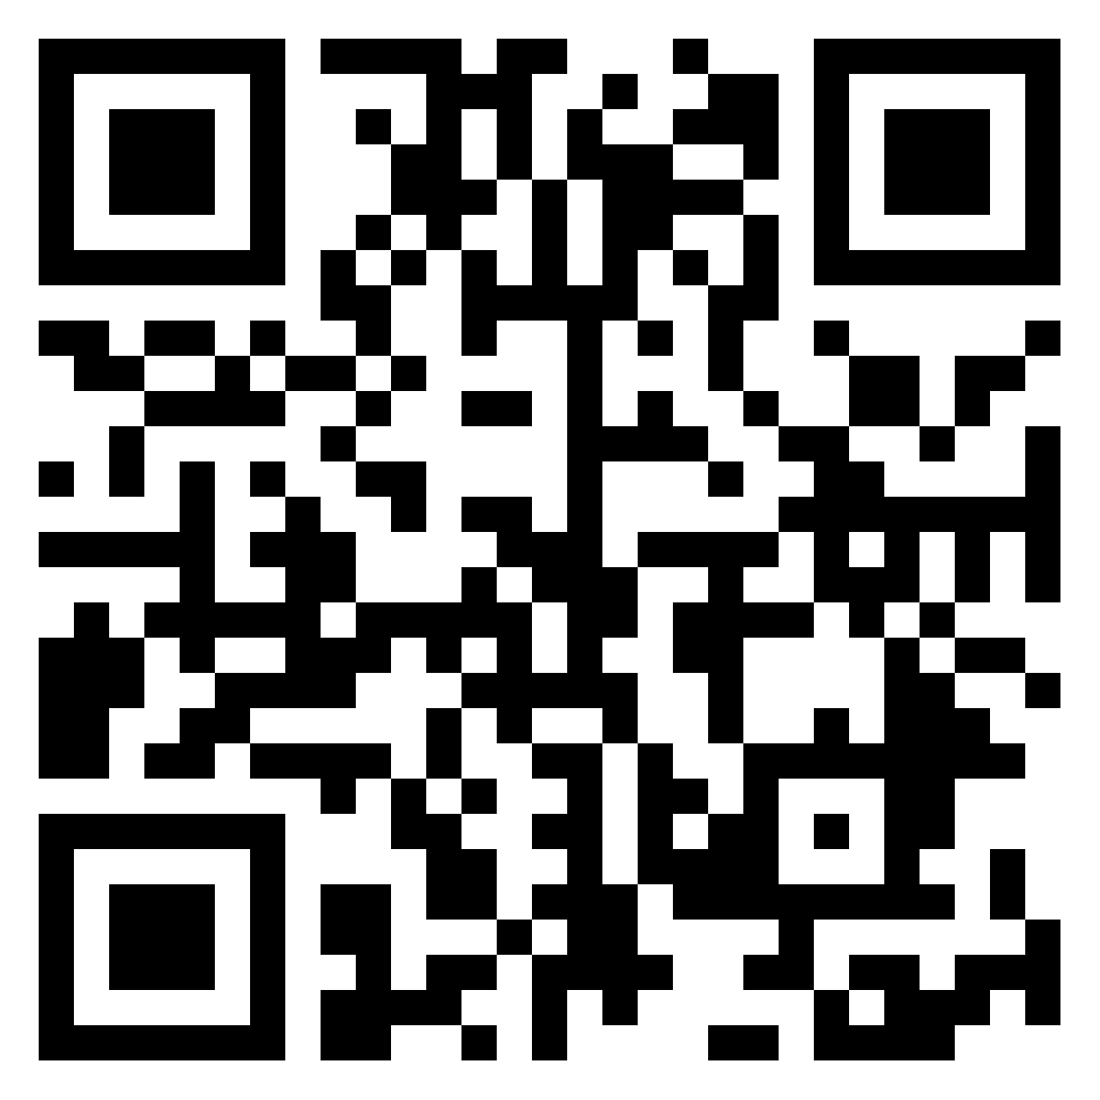
WRITE HERE, BRIEFLY, YOUR GAMIFIED ACTIVITY!

Slide 28

Thank you!
G
A
We hope you had fun playing with us!
M
E

Slide 29
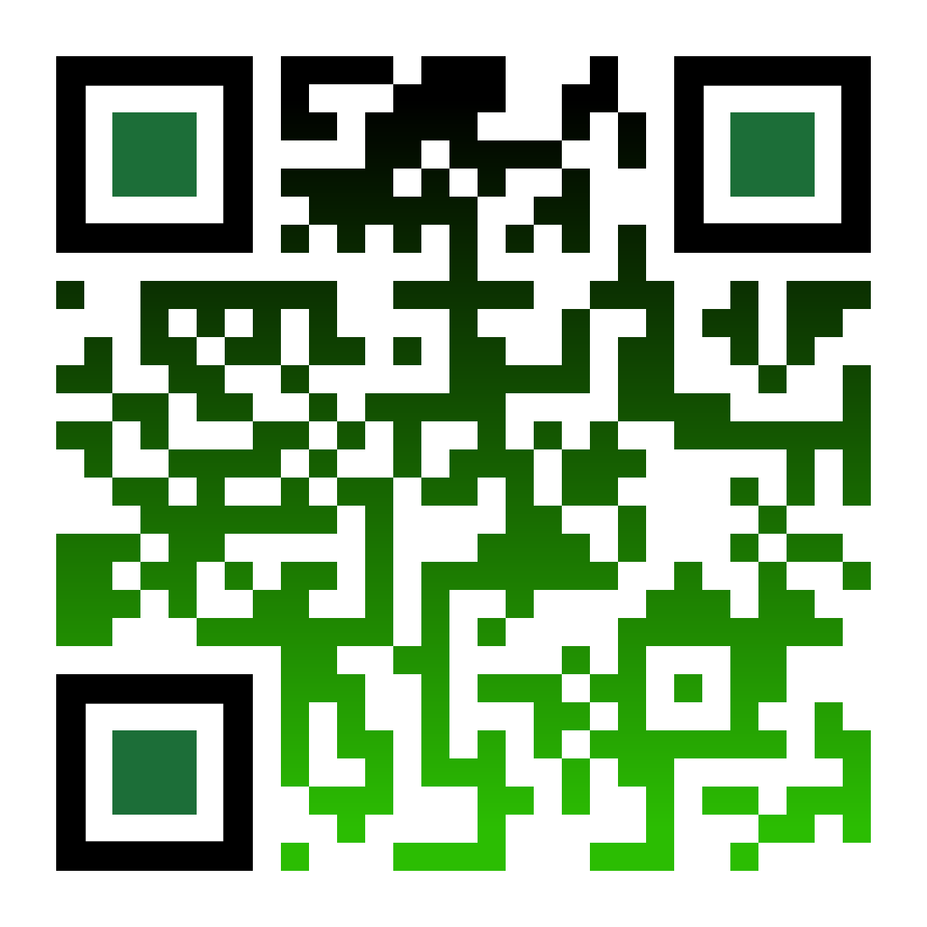
If you want to help us, write your opinion about the G.A.M.E. Model here!

