Slide 1


SEDIN
Creative Methods for Successful Inclusion in Multicultural Schools

Slide 2


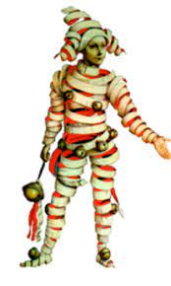





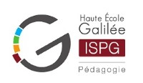
Partners
Center of Higher Education in Theater Studies

Slide 3

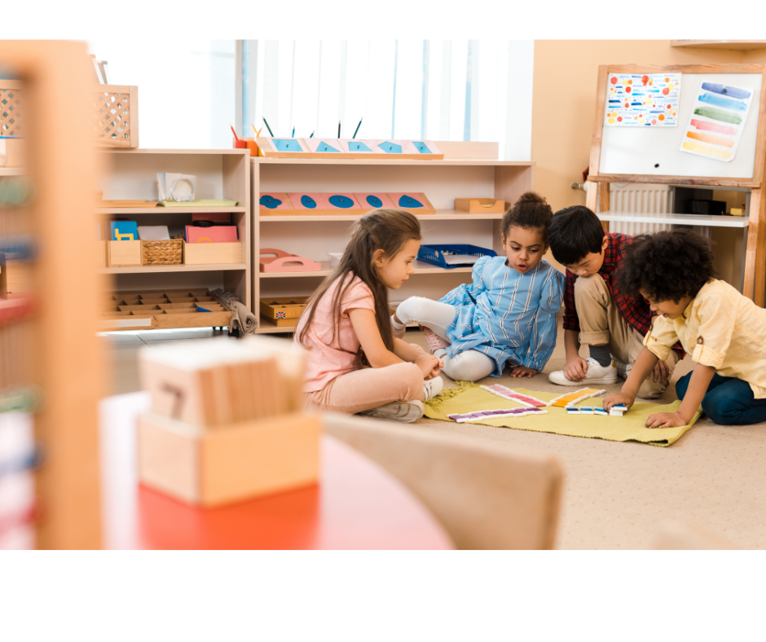
Two Methodologies
Creative Learning
Montessori Method

Slide 4
Goals of the Project
Social inclusion
Cooperation and collaboration in the classroom
Improve classroom environment
Facilitate acquisition of knowledge

Slide 5
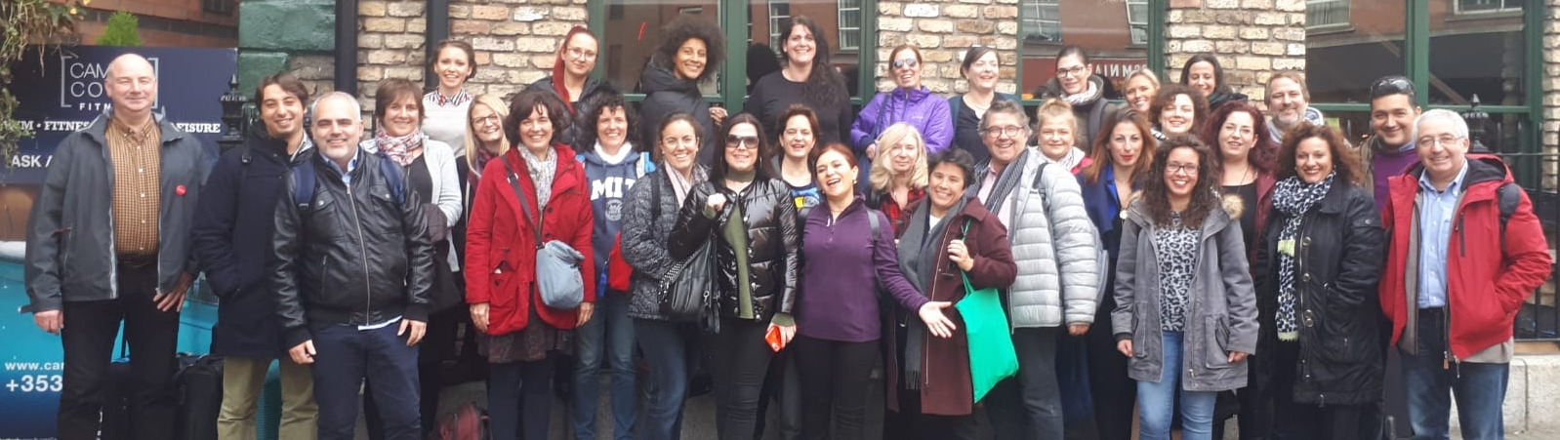
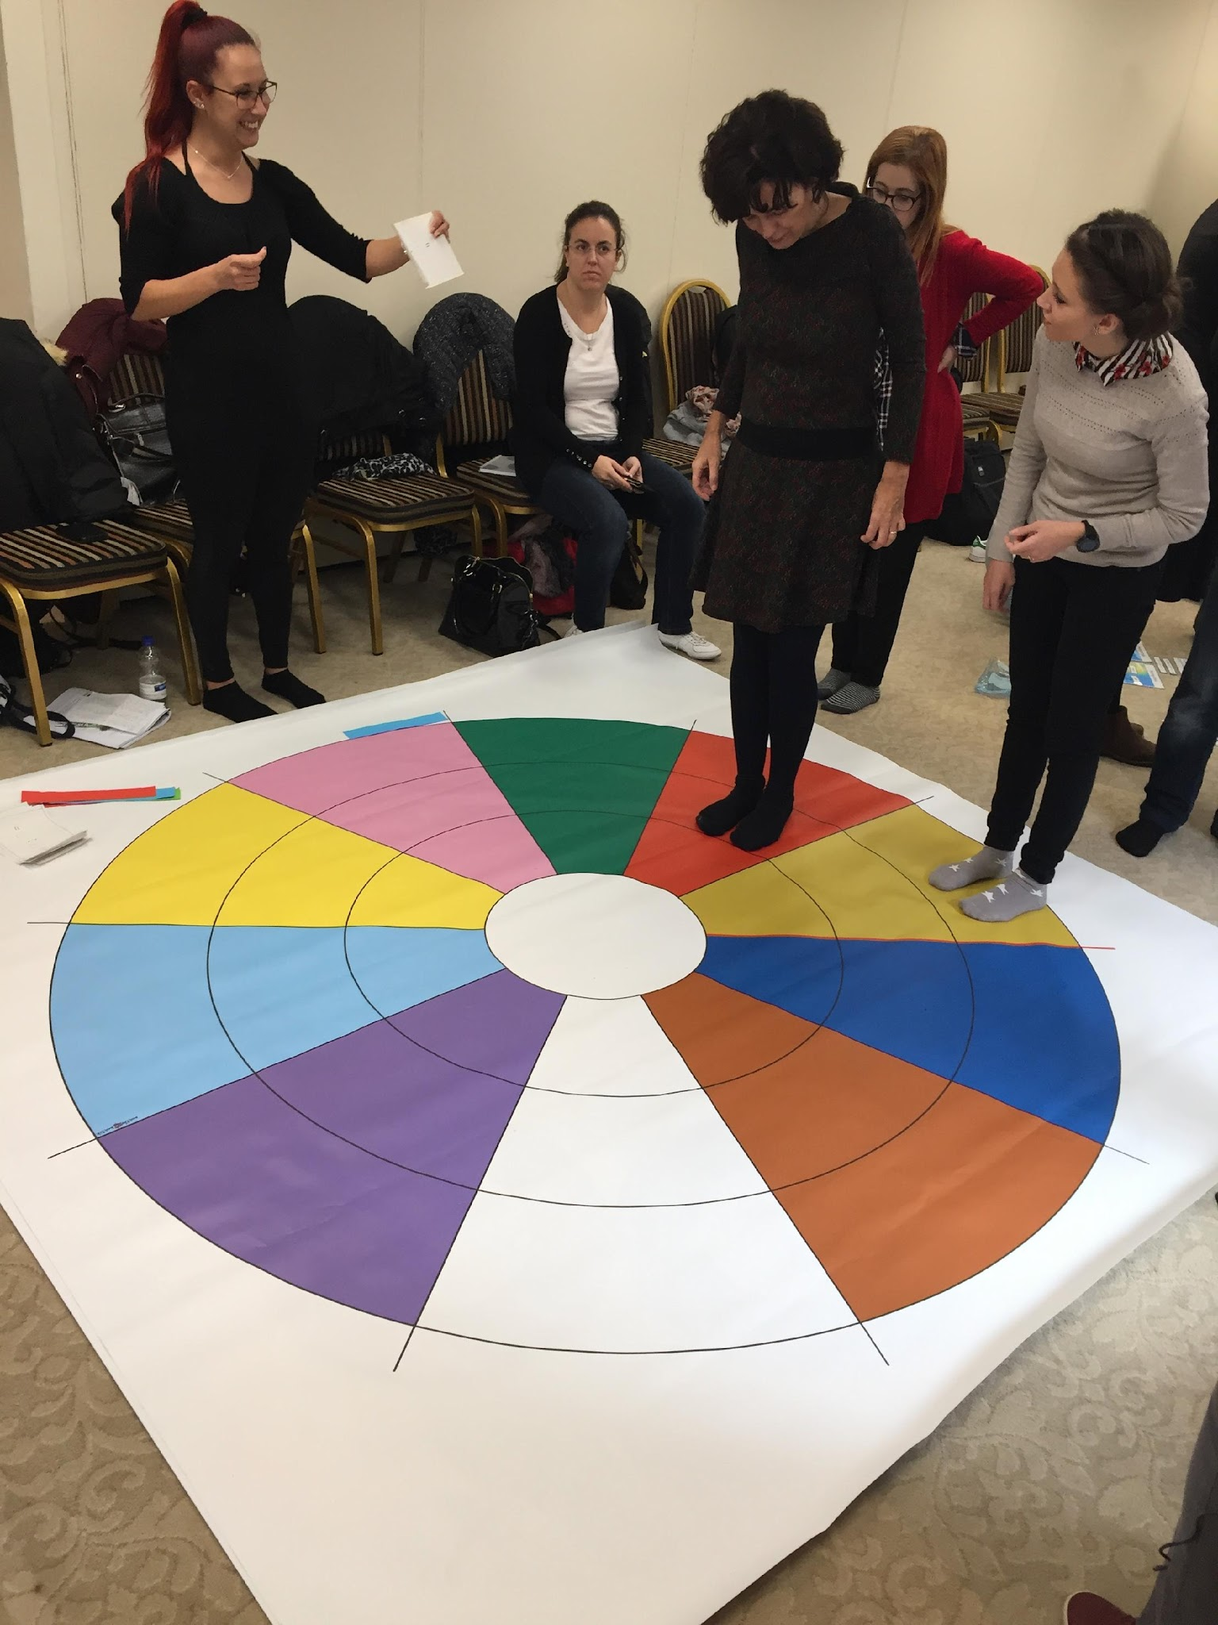
Dublin Teacher Training

Slide 6
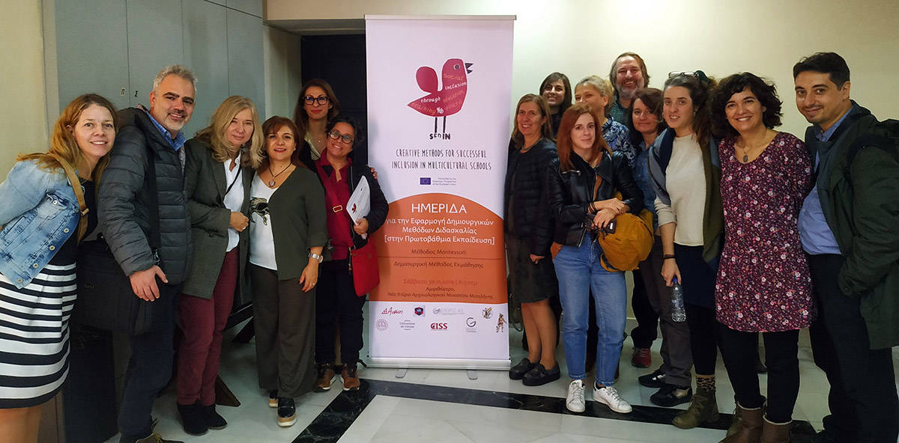
Lesvos Final Transnational Meeting

Slide 7
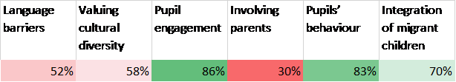
Teacher Responses – how SEDIN helped

Slide 8

Core Montessori Principles
Montessori approach as a life philosophy
The prepared environment
The role of the adult
Concentration
Independent learning
Social and moral development

Slide 9
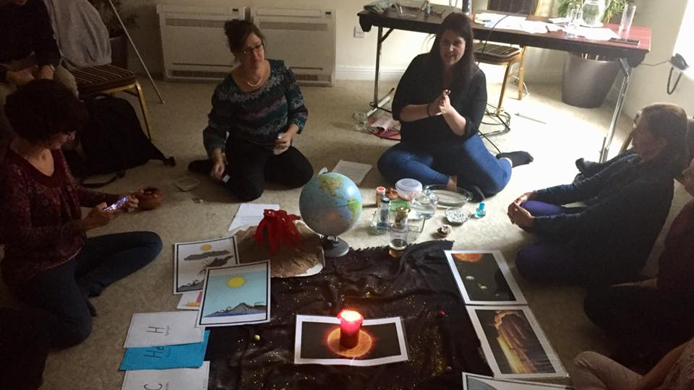
Curiosity and Wonder

Slide 10

Cosmic Education

Slide 11

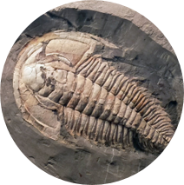
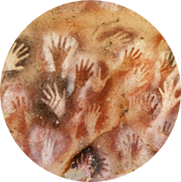
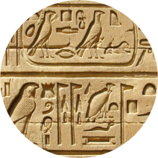
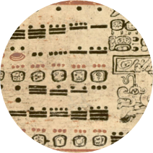
The Great Lessons (Stories)
The Story of the Universe
The Coming of Life
The Coming of Humans
The Story of Writing
The Story of Numbers

Slide 12
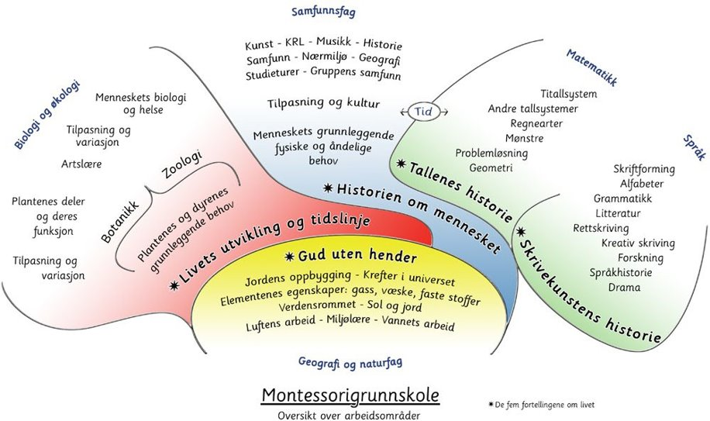

Slide 13

“But it is not always as easy to present the whole as it is to present ​a detail. Then it does not suffice for the teacher to limit herself to loving and understanding the child. She must first love and understand the universe.”​
Maria Montessori, From Childhood to Adolescence

