Slide 1



Creative learning
Acaδimia

Slide 2


Creative learning is a bit long title
2
That’s why we will use the name
CLEAR

Slide 3
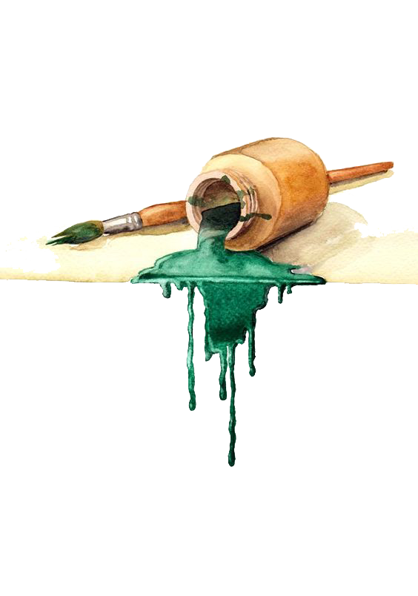
3
An educational tool
How a teacher can use theater techniques to teach his lessons in the elementary school and pre-schools
Notes:
What we want to do? make the long story sort Clear wants to suggest to the teachers of elementary schools a method. : how can they use theatre techniques to teach their lessons in the classroom

Slide 4

4
It is a method that wishes to apply the basic logic of the function of the theatre and arts in the educational process

Slide 5
5
Educator Becomes more creative and inspirational.
For the CHILDREN
it will be like game as the lesson is shifted from
HAVE TO
(to read, to write, to learn by heart)
🡺
WANT TO

Slide 6
6
Educational process as we know it
Relies mainly :
On the books, textbooks, repetition
on the teacher’s knowledge & communication skills.
Is based on a curriculum that centralize on the
abilities that the children must have in order to be
useful and successful in the future

Slide 7
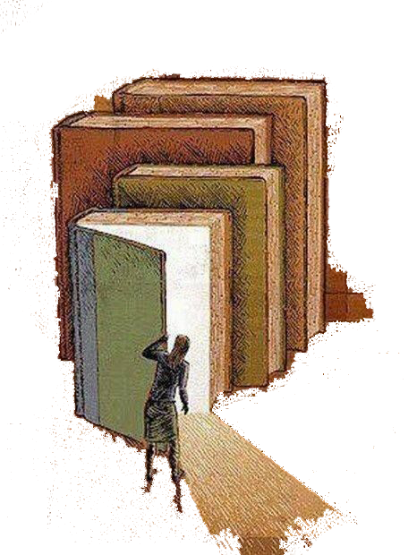
7
…But Art
and all that comes with it,
means creativity, imagination, sensitivity

Slide 8
8
The creative learning process as a method of teaching of the curriculum brings back the actual dimension and the real purpose of education.
We want to move away from sterile, repetitive learning towards more human, experiential situations that give life to the trapped in the book's knowledge.
Notes:
The creative learning process as a method of teaching of the curriculum brings back the actual dimension and the real purpose of education.
We want to move away from sterile, repetitive learning towards more human, experiential situations that give life to the trapped in the book's knowledge
Creative Learning sees the process of learning as a process for change. The emotional and intellectual change leads to maturity and, therefore, to knowledge.

Slide 9
9
The aims
Of Creative Learning
Aim No 1
To make school an attractive place where teachers and students would invest their energy and dreams.
Aim No2
To connect knowledge with pleasure so that students will learn to love learning.
Aim No3
To encourage teachers to re-evaluate their part in the learning process

Slide 10
10
The aims
Of Creative Learning
Aim No4
To build a new kind of teacher-student relationship
Aim No5
To help students explore their talents and inclinations
Aim No6
To develop social values encouraging communication, companionship, and cooperation
Aim 7
To make the school community a field of creative interaction where personal and collective evolution will be equally promoted.
Notes:
Aim No4
To build a new kind of teacher-student relationship
Aim No5
To help students explore their talents and inclinations
Aim No6
To develop social values encouraging communication, companionship and cooperation
Aim 7
To make the school community a field of creative interaction where personal and collective evolution will be equally promoted.
We could list as many other goals that are achieved by introducing art into the learning process. It would be very difficult for me to imagine, for example, bullying and diversity phenomena, student racism in a classroom where children are involved in collaborative processes, playing together, helping each other, complementing each other, etc.

Slide 11
11
The creative function mobilizes and activates
the senses
instict and intuition
the thought, the brain
imagination and self expression
The feeling/sentiment

Slide 12
12
ELEMENTS OF DRAMA
1. Human Context | 7. Time
2. Drama Context | 8. Methexis
3. Roles-Characters | 9. Language
4. Εnergy and interest | 10. Movement
5. Focus | 11. Symbols
6. Imaginative Place | 12. Mood
Notes:
The utilization of theatrical techniques and the development of a structured methodology are integral components of creative learning. In addition, we incorporate both creative and functional components from many art forms such as painting, music, and dance. Primarily, the focus lies on components of theatre, since they encompass action and interactions within a collective social experience, rather than an individual one.
In the realm of theatre, an artistic discipline, our focus lies primarily on achieving a flawless and comprehensive final outcome that is deemed worthy of observation. Conversely, within the domain of Creative Learning, our attention is directed towards the medium, techniques, and methodologies employed, while the ultimate evaluation of success is contingent upon the students' experiential engagement and mastery of the subject matter at hand.
It is reiterated that the confinement of creative learning inside the parameters of a "work of art" should be avoided. The concept of "beauty" should not be a primary focus of our attention, as it is often prioritized in the context of cultivation. It is imperative to consider the efficacy of various learning methods such as play, creation, acting, and experiential learning. The question at hand pertains to our level of proficiency in a particular field of study. The question at hand pertains to the extent to which we are able to incorporate and internalize acquired knowledge.

Slide 13
13
Not too many theories, please!
In a few words… the method must be able
to answer to the teacher’s question
WHAT I HAVE TO DO?

Slide 14
14
1
Using your imagination, imagine the course like… images
Notes:
Similar to a cinematic production comprised of individual, stationary visual elements known as frames.
Create a basic "storyboard" by illustrating a visual representation for each segment of the instructional session. Using this approach, you can maintain a systematic arrangement of the instructional content and have a readily accessible guide.

Slide 15
15
2
Methodically, gather all the materials you need
Notes:
A few, simple and everyday ingredients that we can find in our home. Measuring paper, A4 paper, paints, a basket or a box, a piece of cloth from an old sheet, a piece of thin rope, etc. can be very useful and can be used many times in different lessons. If the teacher does some Creative learning he will get objects that he will use many times in different ways and so he will need less and less. Of course a relationship can be developed with the students and parents so that he can have their help in this point.

Slide 16
16
3
By making a prologue, capture the imagination of children
Making a simple scenario.
Like a film

Slide 17

17
4.
Who are “the heroes” of the Story?

Slide 18
18
5
Personalize these “heroes”
(The numbers, the chemical elements etc can take human form for the sake of the lesson)

Slide 19
19
6
Define the relationships that the heroes have between them so as to specify the plot
What are they seeking for? What are they claiming? What are they afraid of? What are they avoiding?

Slide 20
20
7
Find a simple myth/story
A story where the "heroes" can live can be protagonists, can develop their relations, they can talk, etc.
What are they seeking for? What are they claiming? What are they afraid of? What are they avoiding?

Slide 21
21
8
Devise or borrow from other sources an exciting space
(tales, plays, mythology, etc.)

Slide 22
22
9
Formulate the simple scenario (you made in the beginning) into action, implemented by you and the students
Briefly, specify the main successive phases of which the action must pass to reach the desired result

Slide 23
23
10
After the peak,
end the story quickly
From the peak (crescendo) to the end,
our adventure …should be plain and simple.
Keep for the finale a small surprise, an overthrow.

Slide 24
24
Evaluation in the classroom
The issue of evaluation and assessment in the Creative Learning process is more fruitful as well as sensitive.
The student is not being evaluated in the traditional way (teaching, studying, examination, marking), But his/ her progress and change is being evaluated in the whole school year.

Slide 25
25
How productive they have been
If they were concentrated and engaged to the goal of the lesson if he/she take advantage and used the suitable techniques
If they have chosen and participate collectively and passionately, to the activity.

Slide 26
26
The evaluation will involve
The quality of the character
Details of the behaviour
Paedopsychology issues

Slide 27
27
Problems which other wise will be hidden will be more obvious and come to the surface easier and faster
in the Creative learning procedure.
Hyperactivity
Learning Disabilities
Dyslexia
Disgraphia
Language disorders
Violence and Bullying behaviours

Slide 28
28
Does CLEAR came to overthrow everything we know so far, about:
Education and teaching.
For how the knowledge passes from
teacher to student
Not at all
CLEAR take advantage from the previous experience
Follows the experience of traditional training.
At the end of each creative lesson, the teacher and his students return, to the board, to the course,

Slide 29
29
Discuss & get the conclusions of the lesson
but now the children
Have awaken their imagination,
Have experienced the lesson,
Became part of the adventure
and they understand it.

Slide 30
30
A case study
The waltz of the stars
Based on the 5th grade Geography
With this case study can be taught lesson like:
The Solar system
The shape of the Earth and its position in the solar system
The Earth moves
The movements and the climate of the earth.

Slide 31
31
Materials for the lesson
A flashlight
A cd player / tape recorder, or internet connection with youtube
A famous waltz that could be “Blue Danube”, or “Traviata” by Verdi,
or whatever the teacher chooses
Tags with the names of planets (Mars, Venus, Earth etc.).
The tags are made by the children at the beginning of the course
as a separate painting activity and hang them up with a cord
around their necks or with a paper clip pinned to their clothes.
The teacher’s bell

Slide 32
32
Layout of the classroom
The desks-chairs must be by the walls of the class-room so as to have free space in the middle to move. The teacher makes concentric circles with a chalk or paper-tape on the floor.
The number of circles must be half the number of children in the class because the children will be divided in pairs.
It will be good if the concentric circles are as many as there are in our solar system stars. It will be better, more exciting and funny if we have a relative blackout by the school’s curtains so as the light of the flashlight to have more extraordinary results

Slide 33
33
Phase 1 Dance activity
With the guidance of their teacher, children learn to waltz.
We do not care how well they will waltz. Just good enough so as they can twirl and keep on the circles that are set from the beginning on the floor.
The teacher stands at the center of concentric circles and illuminates the flashlight. The music plays and scatters the melody of the whole class. Off course the flashlight falls on the pair of children when they pass in front of it. So a pair is illuminated on one side and not the other. Just like the planets illuminated by the sun.
The teacher helps with the proper moves, that flashlight=sun falls accordingly and makes the lesson more understandable.

Slide 34
34
Phase 2
The bell rings and children are immobilized. The teacher gives the tags with the names of the planets in each pair (Mars, Earth, Saturn etc).
The music resumes and children dance. The teacher with the flashlight illuminates the planets as the sun in our solar system.
At teacher΄s own discretion, action can stop to correct or clarify the details (How planetary paths do not overlap and do not strike one another, slower one planet in relationship with someone else who turns faster and other details of the lesson.

Slide 35
35
The waltz fills the classroom.
The children swirl around in their own ways.
The teacher from the middle guides them.
The teacher rings the bell and stops the music for a moment…
Talks about PTOLEMEUS and his mistake
to place earth as centre of the Universe.
The music continues and after a while the bell sounds again.
The teacher talks about COPERNICUS.
And again the music goes on…
Third bell-sound.
The teacher explains how the planets turn
around the sun and at the same time around themselves…
uses the flash-light to show it.
Explains how night follows the day… and winter, summer…
Talks about how the sun is close to earth in the summer
and warms it and far at winter and its cold.
Phase 3
Movement-animation
Duration 25 ΄

Slide 36
36
4th Phase
Description of lesson-discussion
Question & evaluation
Duration 15΄
The students sit at their desks.
The teacher explains and focuses on the lesson by drawing on the blackboard or using slides or the sphere.
Now he can teach the course in the traditional way, using concepts, explanations and definitions.
But now the students have experienced the lesson, have images and related representations and can understand without having to memorize the lesson from the book.
Notes:
Creative learning is based on certain conditions that are clear and accepted by all. Children and teachers. It is a disciplined activity although it seems free and open. Children's self-determination is necessary on the one hand but it must be channelled in ways that complete and serve the subject matter we are considering and teaching. And that is why rules are necessary. A basic rule is discipline in the teacher's guidance.
The teacher must always have the decisive say even though sometimes the teacher does not have to impose it because the action is "going well". However, if we want Creative Learning to produce the results we expect, there must always be the possibility of stopping the action and correcting the directions it has taken. Return to the objectives of the lesson. The teacher must be able to talk, correct, reposition persons and relationships without hindrance. Children must have clear goals and conditions and follow them faithfully, step by step.
It is natural in the first attempts that there are points to be checked. However, the constant friction with the method, the knowledge of the individual elements creates a different perspective towards the classroom, the lesson, the material and the relationships in the classroom. This OTHER perspective is established and makes the classroom have another bond. A synchronicity both in the communication between its members and in the effectiveness of the lesson.

Slide 37
37
CLEAR seeks to make :
The school a place of creativity and inspiration.
The teacher to become an enlightened guide,
children to be not just classmates but partners
The must to be want

Slide 38
38
www.creativitylearning.eu

Slide 39
Thank you very much
For your patient

